Slide 1

HIPAA Privacy and Security Awareness
Core Training
AFMS HIPAA Privacy office
AFMSA/SG3SA
Current: January 2012

Slide 2
Purpose of The Briefing
Current guidance from the Office of the Assistant Secretary of Defense for Health Affairs (OSD/HA) requires all workforce members within the Military Health System (MHS) to complete standardized HIPAA training using the centrally managed JKO training platform. Some Air Force facilities are unable to use this system due to connectivity issues, and have been granted a waiver to deliver training by alternative means. This presentation serves as the approved HIPAA Privacy and Security awareness training for Air Force Medical Service (AFMS) facilities that are unable to utilize the JKO training platform.
Department of Defense (DoD), and Federal Regulations require employees of a Covered Entity to receive Health Insurance Portability and Accountability Act (HIPAA) training upon initial assignment to the workforce, and supplemental training when an individual’s duties and responsibilities are affected by a material change in policies
and procedures. Within the Air Force, AFI 41-210 requires initial HIPAA awareness training be provided within 30 days
of an individual being assigned to the workforce, and annually thereafter.
This training will familiarize you with the general provisions of the HIPAA Privacy and Security Rules, and how their requirements apply to you as a workforce member within the Air Force Medical Service. After reviewing the presentation you will:
Have a basic understanding of the HIPAA Privacy and Security Rules
Be familiar with the rights afforded individuals under HIPAA
Understand how to properly safeguard protected health information
Understand the guidelines for using and disclosing protected health information in performance of your duties
Know what to do in the event of protected health information becoming lost, stolen, or compromised
The HIPAA Privacy and Security Officers at your current duty assignment will augment this training with additional information as necessary to address local policies and procedures specific to your facility, and/or your current job role.

Slide 3
Briefing Content
HIPAA In A Nutshell
HIPAA in the AFMS
Important Terms and Acronyms
The Privacy Rule
The Security Rule
Putting it All Together

Slide 4
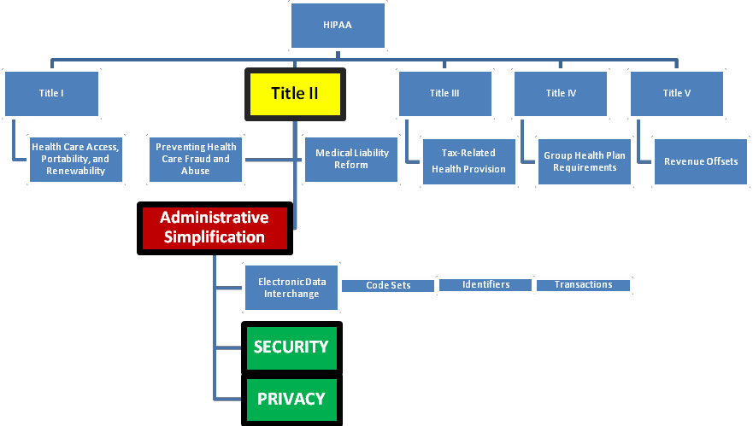
HIPAA In A Nutshell
(What it is)
What HIPAA Is
Public Law 104-191, also known as the Health Insurance Portability and Accountability Act (HIPAA)
Passed by the 104th Congress in 1996
Implemented in the Code of Federal Regulations (CFR)
Privacy and Security, which align under Administrative Simplification, represent only two components of HIPAA

Slide 5
HIPAA In A Nutshell
(The Who and What)
WHAT HIPAA DOES
  The lay public usually thinks of “privacy” when they hear the word HIPAA, but in fact the purpose of HIPAA reaches much further, to include efforts to:
    Improve the portability and continuity of health insurance coverage
    Combat waste, fraud, and abuse in health insurance and health care delivery
    Promote the use of medical savings accounts
    Simplify the administration of health insurance
WHO MUST COMPLY WITH HIPAA
  Any individual or organization that meets the definition of a covered entity
    A simplified definition of a covered entity is: A health plan (e.g., TRICARE), a health care clearinghouse, or a health care provider who transmits any health information in electronic form in connection with a transaction
  Business Associates must also comply with certain aspects of the HIPAA Rules
    A simplified definition of a business associate is someone who is not a member of the covered entity workforce, but performs activities on behalf of the covered entity that involve the use or disclosure of protected health information
THE REQUIREMENTS FOR THOSE WHO MUST COMPLY, INCLUDE:
  Develop policies & procedures to ensure compliance with the HIPAA Privacy and Security Rules
  Enforce employee compliance with policies and procedures, to include sanctions (discipline) when required
  Develop and publish a Notice of Privacy Practices that explains patient’s rights and how their health information will be used
  Ensure employees are trained on HIPAA requirements and understand how HIPAA is applicable to their work environment

Slide 6
HIPAA In A Nutshell
(Interaction with Other Rules)
Other laws and regulations continue to apply, and must be observed in conjunction with HIPAA as you perform daily activities within the covered entity. These laws and regulations include:
  Freedom of Information Act (FOIA)
  Privacy Act of 1974
  Alcohol, Drug Abuse, and Mental Health Administration Reorganization Act
  Other DoD and Air Force guidelines such as Information Assurance instructions
A few words about the Privacy Act
  It is important to emphasize the fact that as an entity within the Federal Government we are required to comply with the Privacy Act of 1974 (PA) as pertains to Personally Identifiable Information (PII)
  Identifiable health information is a subset of PII, and therefore subject to the requirements identified in DoD 5400.11-R and AFI 33-332
  AFMS facilities must comply with all requirements of both the Privacy Act and HIPAA
    Compliance with one rule does not necessarily satisfy the requirements of the other
    All Air Force personnel must complete Privacy Act training as part of the annual Total Force Awareness Training (TFAT) program

Slide 7
HIPAA In A Nutshell
(Penalties For Non-Compliance)
The U.S. Department of Health and Human Services Office for Civil Rights (HHS/OCR) has oversight of HIPAA compliance
Enforcement is predominantly complaint-driven; if an employee or beneficiary makes a complaint, HHS/OCR will investigate it.
HHS has the authority to investigate and subpoena Covered Entities
Resolution is focused on assisting the covered entity to achieve voluntary compliance
  When necessary, a covered entity may enter into a resolution agreement
  Resolution agreements often involve substantial amounts of money and ongoing oversight by HHS/OCR
Other penalties for violating HIPAA can include civil monetary penalties and criminal penalties
Civil Monetary Penalties are applied in a tiered system consisting of four broad categories
Criminal penalties range from $50,000.00 and/or one year imprisonment to $250,000.00 and/or 10 years imprisonment
TIER | DESCRIPTION | PENALTY
A | The offender did not know, and with due diligence, likely would not have known | $100 - $50,000 for each violation, total for all violations of an identical requirement during the same calendar year cannot exceed $1.5M
B | Due to reasonable cause, not willful neglect | $1,000 - $50,000 for each violation, total for all violations of an identical requirement during the same calendar year cannot exceed $1.5M
C | Due to willful neglect, but was corrected | $10,000 - $50,000 for each violation, total for all violations of an identical requirement during the same calendar year cannot exceed $1.5M
D | Due to willful neglect, but was NOT corrected | $50,000 for each violation, total for all violations of an identical requirement during the same calendar year cannot exceed $1.5M
☞ Covered Entities are prohibited from retaliating against complainants or whistleblowers

Slide 8
HIPAA In A Nutshell
(Penalties For Non-Compliance)
☞ PRIVATE SECTOR: Examples of non-compliance and resulting actions
Resolution Agreements http://www.hhs.gov/ocr/privacy/hipaa/enforcement/examples/index.html
2011: A covered entity agreed to pay $1 million and to develop and implement a comprehensive set of policies and procedures to safeguard the privacy of its patients. The incident involved the loss of protected health information (PHI) of 192 patients in paper form.
Civil Money Penalty http://www.hhs.gov/ocr/privacy/hipaa/enforcement/examples/index.html
2011: HHS imposed a civil money penalty (CMP) of $1.3 million on a covered entity that violated patients’ rights by denying them access to their medical records. HHS also imposed an additional $3 million in penalties on the entity for refusing to respond to OCR’s repeated demands to produce records and failure to cooperate with OCR’s investigation.
Criminal Penalties http://littlerock.fbi.gov/dojpressrel/pressrel09/lr102609.htm
2009: Three individuals (a physician and two support staff) plead guilty to misdemeanor violations of the health information privacy provisions of the Health Insurance Portability and Accountability Act (HIPAA) based on their accessing a patient’s records without any legitimate purpose. The physician was sentenced to one year of probation, a
$5,000 fine to be paid in 60 days, and 50 hours of community service educating professionals on HIPAA. One support staff member was sentenced to one year probation and a $2,500 fine, the other was sentenced to one year probation and a $1,500 fine.
☞ MILITARY HEALTH SYSTEM: Examples of non-compliance and resulting actions
Resolution agreements, Civil Money Penalties and Criminal penalties have yet to be applied within the DoD
Within the AFMS, violations of HIPAA are generally handled at the local level and have resulted in actions ranging from verbal and written counseling’s, to UCMJ action for military personnel, and (up to) dismissal for civilian personnel. Violations by contract personnel are governed by contractual remedies through the contracting officer.

Slide 9
HIPAA IN THE AFMS
Implementation
The HIPAA Privacy Rule is implemented by DoDI 6025.18-R and AFI 41-210
The HIPAA Security Rule is implemented by DoDI 8580.02-R and AFI 41-217
How We Fit In
The Military Health System (MHS) is a special type of Covered Entity, known as an “Organized Health Care Arrangement” (OHCA)
Within the MHS, the Air Force Medical Service (AFMS) is also a covered entity
Within the AFMS, each individual Medical Group is its own covered entity
☞ All medical personnel under the functional control of the Air Force Surgeon General (USAF/SG) are members of the AFMS covered entity and must comply with HIPAA; virtually every individual who works under the umbrella of the Air Force Medical Service, to include military personnel, civil service personnel, contractors, and even volunteers must observe HIPAA requirements
 | Where HIPAA Does Apply For the most part, AFMS personnel must always observe HIPAA, regardless of physical location AF personnel must observe HIPAA requirements:  While operating in the continental United States  While operating in an overseas theater  While operating under field conditions Deployed locations Mobile medical units US Navy hospital ships |  | Situations in Which HIPAA Does Not Apply Healthcare provided to foreign nationals outside of the United States Armed Forces Repository of specimen samples for the identification of remains Records maintained by DoD day care centers Reserve component medical activities which are not practicing in an MTF Reserve components practicing outside the authority of MTFs and not engaged in electronic transactions covered by DoD 6025.18-R Military Entrance Processing Stations Education records Healthcare provided to POWs and detainees DoD drug abuse testing programs

Slide 10
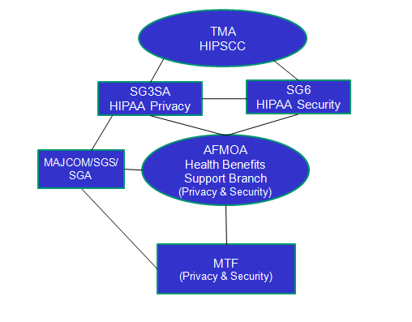
HIPAA IN THE AFMS
Air Force HIPAA compliance and oversight is a cooperative effort between AFMSA, AFMOA, and the local MTF HIPAA Team…
The Air Force Medical Support Agency (AFMSA)
  Located in the National Capitol Region
  Location of the AFMS HIPAA Privacy and Security Officers
  Responsible for policy development and policy interpretation as necessary to ensure ongoing AFMS compliance with all HIPAA privacy and security requirements
  Provides HIPAA interface between the AFMS and the TMA Privacy and Civil Liberties Office, HHS/OCR, Sister Services, Secretary of the AF, and other agencies
The Air Force Medical Operations Agency (AFMOA)
  Located in San Antonio, Texas
  Responsible for implementation and maintenance of operational activities in support of AFMSA policy
  Integrates privacy and security policy guidance into a comprehensive HIPAA compliance program
  Provides SME support to all MTF, MAJCOM, and DRU HIPAA
personnel
Medical Group HIPAA Privacy and Security Officers
  Implements and monitors local HIPAA compliance activities
  SME and principal advisor to MDG/CC for HIPAA Privacy and Security compliance

Slide 11
Important Terms and Acronyms
BA BAA CE
HITECH MHS
MTF OHCA PHI TPO
Business Associate
Business Associate Agreement Covered Entity
Health Information Technology for Economic and Clinical Health Act Military Health System
Military Treatment Facility
Organized Health Care Arrangement Protected Health Information
Treatment, Payment and Healthcare Operations
Covered Entity
A health plan, a health care clearinghouse, or a health care provider that transmits healthcare information in electronic form in connection with a transaction.
Disclosure
The release, transfer, provision of access to, or divulging in any other manner of information outside the covered entity holding the information
Health Information
Any information, in any form or medium, that is created or received by a healthcare provider… and relates to the past, present, or future physical or mental health or condition of an individual; the provision of healthcare to an individual; or the past, present, or future payment for the provision of healthcare to an individual
10

Slide 12
Important Terms and Acronyms
Individually Identifiable Health Information
Information that is a subset of health information, including demographic information collected from an individual… and that identifies the individual or gives a reasonable basis to believe the information can be used to identify the individual
Protected Health Information (PHI)
Basically a combination of the two definitions above: Individually identifiable health information that is transmitted or maintained by electronic or any other form or medium
Minimum Necessary
The minimum amount of protected health information necessary to accomplish a permitted use or disclosure
Treatment, Payment, and Healthcare Operations
Treatment: means the provision, coordination, or management of health care, including consultations and referrals between health care providers
Payment: includes, but is not limited to, efforts to obtain premiums or reimbursement; determine eligibility; billing; claims management; review of health care for determining whether it is “medically necessary”; and utilization review
Healthcare operations: includes quality assessment and improvement activities; case management and care coordination; reviewing the competence or qualifications of health care professionals; underwriting; arranging for legal services; business planning; customer services; resolution of internal grievances; creating de-identified information; fundraising; and other activities
Use
The sharing, employment, application, utilization, examination, or analysis of individually identifiable health information within an entity that maintains the information

Slide 13

The Privacy Rule
A CLOSER
LOOK AT THE PRIVACY RULE
The Privacy Rule applies to health information in any form
Establishes a baseline national standard for the protection of health information while continuing to allow the flow of information as needed to provide health care
Gives individuals more control over the release of their health information
Sets boundaries on the use and disclosure of health records
Establishes safeguards that must be met to protect the privacy of health information

Slide 14
The Privacy Rule
(PHI)
MYTH #1: If there’s no diagnosis, it isn’t PHI
Take another look at what constitutes Protected Health Information (PHI)
HEALTH INFORMATION
Any information, in any form or medium, that is created or received by a healthcare provider… and relates to the past, present, or future physical or mental health or condition of an individual; the provision of healthcare to an individual; or the past, present, or future payment for the provision of healthcare to an individual
INDIVIDUALLY IDENTIFIABLE HEALTH INFORMATION
Information that is a subset of health information, including demographic information collected from an individual… and that identifies the individual or gives a reasonable basis to believe the information can be used to identify the individual
+
=
PHI
☞ There is long-standing confusion as to whether items such as DNIF Forms, Quarters Notifications, Duty Limitations, Physical Profiles, and PIMR Reports rise to the definition of PHI; this is due in large part to the fact the documentation itself contains little, if any specific medical information. With that said, these types of documents are created within the Covered Entity by (or at the direction of) a healthcare provider, relate to the condition of the individual (i.e. their ability to perform duties), and are generally filed within the designated record set (paper or electronic); therefore these types of documents meet the definition of health information. By adding individually identifiable data such as the individual’s name and/or SSAN, the documentation becomes PHI.
☞ By definition, virtually all patient-related documentation created within the Covered Entity is “health information”

Slide 15
The Privacy Rule
(PHI)
MYTH #2: If there’s no name or SSAN, it isn’t identifiable
Not true; there are 18 identification factors that are considered identifiable (refer to DoD 6025.18-R, C8.1.3)
Items considered to be identifiable Case Study
Names
Social security numbers
Telephone numbers
Account numbers
Biometric identifiers, including finger and voice prints
Fax numbers
Medical record numbers
Certificate or license numbers
Web Universal Resource Locators (URLs)
Full-face photographic images and any comparable images
Electronic mail addresses
Health plan beneficiary numbers
Device identifiers and serial numbers
Internet Protocol (IP) address numbers
All geographic subdivisions smaller than a State
Vehicle identifiers and serial numbers, including license plate numbers
All elements of dates (except year) for dates directly related to an individual, including birth date, admission date, discharge date, date of death; and all ages over 89
Any other unique identifying number, characteristic, or code
Let’s take another look at the definition of Individually Identifiable Health Information: Information that is a subset of health information, including demographic information collected from an individual… and that identifies the individual or gives a reasonable basis to believe the information can be used to identify the individual
An e-mail message was sent to the “.mil” account of several active duty sponsors; recipients were listed in the “To” box, not the “Bcc” box. The body of the message did not contain any identifiable information; it simply requested the sponsor to make an appointment at the clinic for their child to receive an overdue immunization.
  The sponsor’s name and unit of assignment were visible to all recipients
  Recipients of the message who knew other recipients were able to connect a sponsor to a child, and thereby reasonably identify the child (or children) requiring immunizations
  The incident resulted in a privacy complaint
Information is not rendered de-identified unless all 18 identifiers are removed or expert statistical analysis documents the risk of identifying an individual is acceptably low

Slide 16
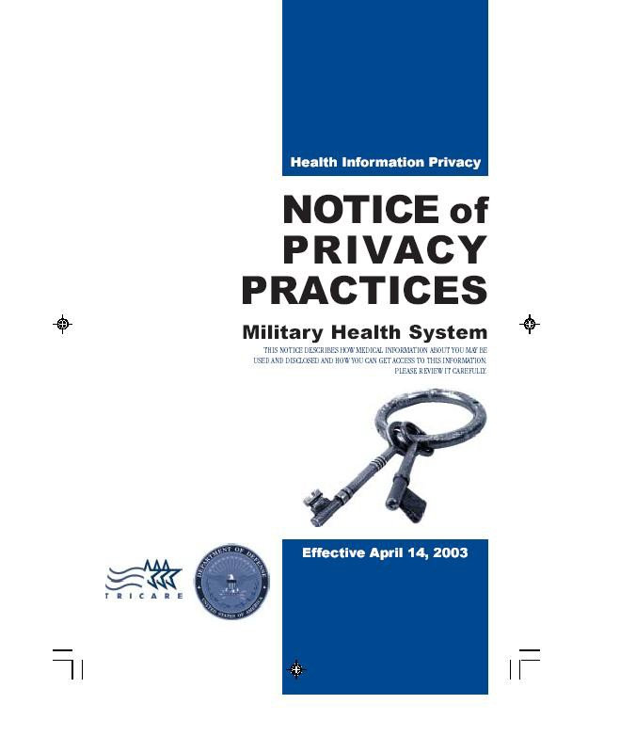
The Privacy Rule
(Patient Rights)
The Privacy Rule affords individuals certain rights
The right to receive notice of privacy practices regarding their health information
  The Military Health System (MHS) Notice of Privacy Practices (NoPP) is available to all beneficiaries and explains how the MHS uses the beneficiary’s health information, as well as the beneficiary’s rights regarding their health information
  Each MTF is responsible for providing beneficiaries with the MHS NoPP
  Copies of the NoPP should be readily available throughout the clinical areas of the Medical Group for beneficiaries to review and take with them
  The NoPP must be prominently posted within the facility
  If the Covered Entity maintains a web site that provides information about its services or benefits, the web site must contain a prominently posted link to the NoPP
☞ If a beneficiary asked, could you explain the purpose of the NoPP to them in general terms?
Click here to read the MHS NoPP

Slide 17
The Privacy Rule
(Patient Rights)
Request to inspect (review) and obtain a copy of their records
  Individuals have the right to review and obtain a copy of their protected health information
    There are exceptions to the right of access; some are reviewable, others are not
  The covered entity must act on a beneficiary’s request within 30 days of receipt
  The covered entity may impose a reasonable, cost-based fee for providing copies
Request an amendment to their records
  Individuals may request the covered entity amend (correct) medical information that is inaccurate or incomplete
  The request may be denied if certain criteria are met; if the request is denied, the covered entity must provide the individual with a written denial and allow the individual to submit a statement of disagreement for inclusion in the record
  The covered entity must act on a beneficiary’s request within 60 days of receipt
Request restrictions on the uses and disclosures of PHI
  Individuals have the right to request the covered entity restrict how their protected health information is used under certain conditions
  A covered entity does not have to agree to the restrictions, but if they do, they must comply with the agreed upon restrictions, except for emergencies

Slide 18
The Privacy Rule
(Patient Rights)
Request an accounting of disclosures
  Individuals have the right to know who has received access to their protected health information
  The request can be for any and all disclosures up to a period of six years preceding the request
  Not all disclosures must be accounted for, such as:
Disclosures for treatment, payment, or health care operations | Disclosures to the individual or as authorized by the individual
Notification of/to persons involved in an individual’s health care or payment for health care | Disclosures to correctional institutions or law enforcement officials for certain purposes regarding inmates or individuals in lawful custody
Disclosures for national security or intelligence purposes | Disclosures for disaster relief
Facility directories | Limited data set
Disclosure accounting includes:
  The date of the disclosure
  The name of the individual or entity that received the information, and address if known
  A brief description of the information disclosed
  A brief statement that reasonable explains the basis (purpose) for the disclosure
Request alternative (confidential) communications
  Individuals may request the covered entity communicate PHI related matters by alternative means or at alternative locations
  The covered entity must accommodate reasonable requests, when possible

Slide 19
The Privacy Rule
(Treatment-Payment-Healthcare Operation)
A healthcare entity may disclose PHI for purposes of Treatment, Payment, or Healthcare Operations without the patients’ authorization:
  “Treatment” - provide/coordinate health care, consults, referrals
  “Payment” - submit claims, obtain premiums, provide benefits
  “Operations” – certain administrative, financial, legal and quality improvement activities that are necessary to run the covered entity’s business and to support the core functions of treatment and payment
☞ EXCEPTION: Except when psychotherapy notes are used by the originator to carry out treatment, or by the healthcare entity for certain other limited healthcare operations, uses and disclosures of psychotherapy notes for treatment, payment, and health care operations require the patient’s authorization
☞ NOTE: As defined in DoD 6025.18-R, DL1.1.29, psychotherapy notes are not part of the official Mental Health record
Examples of commonly encountered TPO activities within AFMS facilities includes:
  Coordinating patient care, patient appointing, and coordinating referrals/consultations
  Peer reviews and Risk Management reviews
  Third Party Collections and billing functions

Slide 20
The Privacy Rule
(Minimum Necessary)
The HIPAA Privacy Rule requires covered entities to take reasonable and appropriate steps to limit the use or disclosure of, and requests for, an individual’s protected health information
  Disclosures of health information should be limited to the minimum amount of information that will accomplish the intended purpose of the disclosure
  Minimum Necessary does NOT apply to the following
    Disclosures to a health care provider for purposes of conducting treatment, payment, or healthcare operations
    Disclosures directly to the individual who is the subject of the information
    Uses or disclosures specifically requested and authorized by the individual who is the subject of the information
    Uses and disclosures that are required by law
The principle of minimum necessary also applies within the covered entity
  Even medical personnel may only access information needed to perform their job, and only in the amount necessary to accomplish the task at hand
  To ensure compliance with these requirements, the covered entity is required to have policies and procedures in place to identify individuals or groups of individuals with access to health information and the types of information they may access; this is known as “role-based-access”
  Members of the covered entity may not access health information without a legitimate requirement, nor
may a member of the covered entity access information in an amount beyond the minimum necessary to accomplish the permitted use or disclosure
There is a difference between having the ability to access
information and having a need to access information. Inappropriate access to health information is a violation of HIPAA and a common beneficiary complaint within the AFMS!

Slide 21
The Privacy Rule
(Disclosures)
The terms use and disclosure are not interchangeable
  A use can be thought of in terms of using the information within the MTF in a permissible manner
  A disclosure can be thought of as a release or transfer of the information to an organization or individual who is external to the MTF
There are three types of disclosures
  Those for which a patient authorization is not required
  Those for which a patient authorization is required
  Those for which the patient must be given the opportunity to either agree with, or object to the disclosure
We do not disclose patients’ protected health information (PHI) for reasons other than treatment, payment, or healthcare operations, unless we get a written authorization or we release and account for the disclosure under one of the acceptable release categories identified in the table below:
As required By Law | For Judicial And Administrative Proceedings
For Law Enforcement Purposes | For Research Involving Minimal Risk
For Cadaveric Organ, Eye Or Tissue Donation Purposes | For Workers Compensation
For Public Health Activities | To Avert A Serious Threat To Health Or Safety
About Decedents | About Victims Of Abuse, Neglect, Or Domestic Violence
For Health Oversight Activities | For Specialized Government Functions (This includes disclosures to command authorities for fitness for duty purposes)
20

Slide 22
The Privacy Rule
(Disclosures)
Incidental Disclosures
  An incidental disclosure can only occur as a by-product of a permissible use or disclosure. In order to be a permissible use or disclosure, there must be appropriate safeguards in place and the minimum necessary standard must be observed (as applicable) to the use or disclosure.
  Said another way, an incidental disclosure generally cannot be prevented and occurs as a result of another use or disclosure that is permissible.
☞ Remember: The disclosure must occur as a by-product of an otherwise permissible use or disclosure in order to be considered an incidental disclosure. If the disclosure occurs as a by-product of an impermissible use or disclosure, then it is not incidental
INCIDENTAL DISCLOSURE
A technician and nurse are in a semi-private patient room taking care of the patient in bed #1. They pull the patient curtain between the beds, speak in hushed tones, and only discuss the patient’s condition as necessary to perform the task at hand. While doing all of this the patient in bed #2 overhears some of the conversation.
Appropriate safeguards observed
Conversation limited to minimum necessary
Overhearing by bed #2 could not be prevented
NOT AN INCIDENTAL DISCLOSURE
A technician enters a patient waiting area and calls a patient’s name. After identifying the patient the technician approaches them and begins to ask questions regarding the patient’s medical history and medications as listed on the clinic’s intake form. Other beneficiaries in the waiting room overhear the discussion.
The conversation was permissible, however
☞
☞

Slide 23
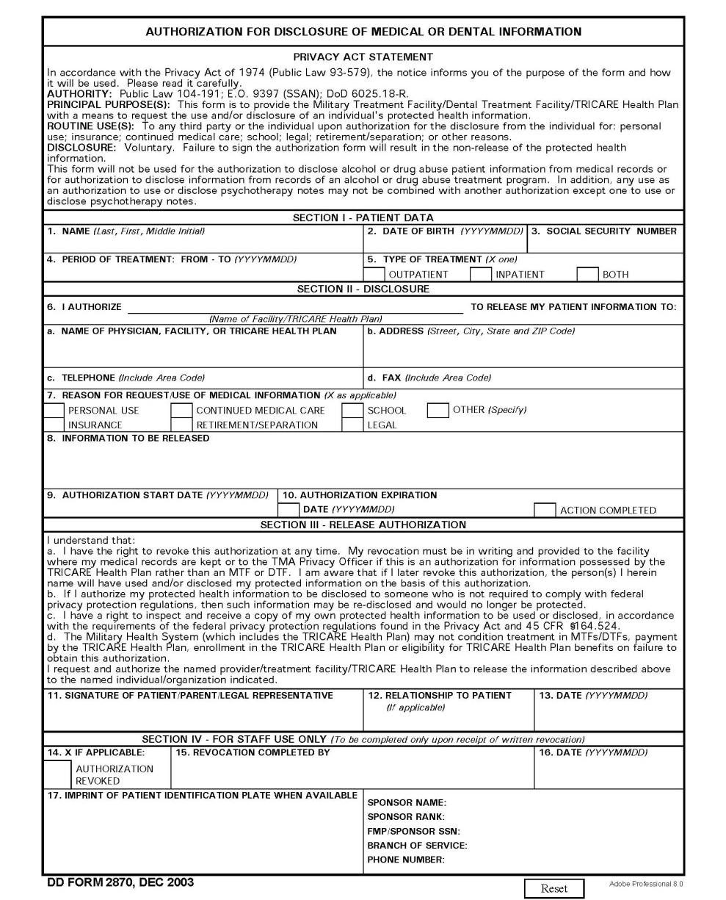
The Privacy Rule
(Disclosures)
Use of Authorizations
  A HIPAA-compliant authorization must be signed by the patient or their personal representative in instances where the patient’s authorization is required for disclosure
  Within the Military Health System (MHS) we use DD Form 2870 for obtaining the patient’s authorization to use or disclose PHI when an authorization is required. This form ensures all required data elements and required statements are properly documented, thus making the authorization “HIPAA-Compliant”
Authorization Requirements
  Authorizations that are received from a non- military covered entity must be carefully reviewed to ensure all the required data elements and mandatory disclaimers are present.
  Refer to DoD 6025.18-R, C5.3 for a detailed list of all requirements
  When in doubt, consult the MTF HIPAA Privacy Officer

Slide 24
The Privacy Rule
(Business Associates)
A business associate is an individual or an organization that performs functions, services or activities on behalf of the MTF that involves the use or disclosure of protected health information belonging to the MTF
  Business associates are not members of the MTF workforce
  Not all services performed on behalf of the MTF require a BAA
Disclosures to business associates can only occur after the MTF obtains reasonable assurances from the business associate that they will properly safeguard the information, and only use it as prescribed in the contract or Memorandum of Agreement that outlines the services to be performed by the business associate
Examples of Business Associate activities include, but are not limited to:
Administrative activities, data analysis, utilization review
Quality Assurance, billing, benefit management, practice management
Clinical services and consulting services
In the Air Force we obtain business associate assurances through a written clause called a Business Associate Agreement (BAA), which is incorporated into all contracts or Memorandum of Agreements for services that involve the use or disclosure of PHI.
☞ To be enforceable as part of the contract, the BAA must be incorporated into the contract, not signed as a “standalone” document
  Individual MTFs must obtain BAAs when securing services at the MTF level
  The AFMS obtains BAAs when securing centralized contracts and/or services for multiple facilities
Examples of Business Associate Agreements executed at the AFMS-level
ORGANIZATION | BAA COVERS
American Association of Blood Banks | Accreditation activities supporting 11 specific AFMS facilities
American Dental Association - CODA | Accreditation activities in support of AFMS dental-related educational programs
Accreditation Association for Ambulatory Health Care | Accreditation activities in support of AFMS outpatient facilities

Slide 25
The Privacy Rule
(Complaints)
Complaints
  The Privacy Rule requires the MTF to provide a process for individuals to make complaints concerning the MTF’s privacy policies or its compliance with privacy policies
  The MTF must document and investigate all complaints received
  The right to file a complaint is not limited to patients; any individual may file a complaint if they believe a violation has occurred
All beneficiary concerns should be taken seriously and addressed at the lowest level possible
  Refer concerns to the patient advocate and/or HIPAA Privacy Officer
  Individuals wishing to file a complaint outside the MTF may do so by contacting the TRICARE Management Activity (TMA Privacy and Civil Liberties Office), or the Department of Health and Human Services Office for Civil Rights (HHS/OCR)
High-visibility Complaints
  Sometimes a complaint arrives at the MTF in the form of an inquiry
    Congressional Inquiries
    HHS/OCR Inquiries
    Inspector General and Commander Directed Investigations
  These types of inquiries have very specific response criteria and strict timelines
  Inquiries such as these should NEVER arrive directly on your desk
    Immediately alert your MTF HIPAA Privacy Officer if you believe the inquiry was directed to you
    Immediately alert your MTF HIPAA Privacy Officer if someone outside the MTF workforce contacts you and asks for information pertaining to an inquiry

Slide 26
The Privacy Rule
(Safeguards)
Safeguards
  Safeguards help ensure the confidentiality, integrity and availability of health information
  MTFs are required to implement reasonable and appropriate administrative, technical, and physical safeguards to protect the PHI under their control
  The Privacy Rule does not identify specific safeguards that must be implemented; this allows individual MTFs to evaluate their unique needs and implement reasonable and appropriate safeguards
The requirement to identify and implement safeguards can be found in both the privacy and security rules. Identifying and implementing safeguards can be as simple as applying common sense to a given situation, or as complex as conducting an in-depth risk assessment and analysis to identify reasonably foreseeable and anticipated risks
  MTFs must identify risks, then implement safeguards to mitigate the risk
  When it comes to safeguards, one size does not fit all. Different facilities will identify different threats; this means some safeguards that are reasonable and appropriate at one facility may be inadequate, unnecessary, or perhaps even inappropriate for another facility
During Hurricane Katrina, numerous healthcare facilities in New Orleans and surrounding areas lost power and vital functions when emergency generators and information systems housed in basements flooded
A tornado in Joplin, Missouri made impact with a hospital, causing significant structural damage to the facility. Medical records and X-Rays were found as far away as 70 miles from the facility in the aftermath of the tornado.
The facilities were located near the coast and most basements were below sea-level.
Hurricanes and flooding are potential threats. Use of basements to house critical infrastructure, medical records, etc is a potential risk
This facility is located in a geographical area prone to tornados. In contrast to the Gulf Coast, the anticipated threat of tornados might result in the basement being selected as the ideal storage area for critical assets

Slide 27
The Privacy Rule
(Safeguards)
Safeguards help ensure the confidentiality, integrity and availability of health information by protecting the data from internal and external threats
Safeguards fall into three broad categories (see examples below):
  Administrative: These are policies and procedures designed to manage the protection of health information
  Physical: As the name implies, these are physical protections and activities designed to limit access to, and manage the protection of health information
  Technical: These safeguards utilize technology to control access to, and safeguard electronic health information
ADMINISTRATIVE | PHYSICAL | TECHNICAL
1. Oral Communications Limiting use of overhead paging systems for contacting patients Not using the speakerphones in areas where conversations can be overheard 2. Facsimile Ensuring fax machines are attended or located in a secured office area Validate fax numbers before sending 3. Photocopiers and Printers Not leaving PHI unattended on printers Limiting individuals that are authorized to photocopy/disclose PHI 4. Use of sign-in sheets and waiting rooms Limiting use and content of sign-in sheets Screen/speak with patients in a private area | 1. Access to PHI Limiting personnel to role-based access to areas where PHI is stored Secure PHI when unattended Position computer monitors where they cannot be seen by unauthorized personnel 2. Work Center Activities Ensure all employees display the MDG identification badge at all times Visitors performing duties within the facility should display their company identification or Air Force identification card and a MDG visitor badge Patients and visitors should be escorted as necessary to ensure they do not access restricted areas | Technical safeguards are most commonly employed to ensure compliance with the Security Rule. Your role is to ensure personal compliance with technical safeguards such as: Proper use and safeguarding of passwords and biometrics used to access information systems Use of encryption and digital signatures for transmission of PHI Not allowing other individuals to use your CAC card or other sign- on credentials to access information systems

Slide 28
The Privacy Rule
(Miscellaneous)
There are other requirements within the Privacy Rule that we will only briefly touch upon, as these topics are seldom encountered within the MTF. Always contact your local MTF HIPAA Privacy Officer for assistance if you encounter these issues
Research
  In general, most research involving humans is conducted under the Common Rule (45 CFR Part 46, Subpart
    and/or the Food and Drug Administration’s human subject protection regulations (21 CFR Parts 50 and 56)
  The MTF may use and disclose protected health information for research if the individual’s authorization is obtained
  MTF may use protected health information without the individual’s authorization if certain conditions are met, such as:
A waiver of authorization is approved by the Institutional Review Board (IRB) or Privacy Board
The PHI is only used to prepare a research protocol and is not removed from the MTF
The research is limited to PHI of decedents
The PHI is de-identified through removal of the 18 identifiers previously described
The PHI is determined to be a “Limited Data Set” and is disclosed through use of a Data Use Agreement
Always consult with your MTF HIPAA Privacy Officer before initiating a research project or before disclosing PHI in response to a researchers request for PHI

Slide 29
The Privacy Rule
(Miscellaneous)
Marketing
  Marketing is a communication about a product or service that encourages recipients of the communication to purchase or use the product or service
  Marketing is not:
    Communicating with the patient about health-related products or services provided by or included in the MHS health plan
    Communicating for purposes of treatment
    Communications related to case management or care coordination
Fundraising
  The Privacy Rule allows fundraising, provided certain requirements are met
  We do not solicit our beneficiary population for fundraising, nor does our MHS Notice of Privacy Practices make reference to fundraising

Slide 30
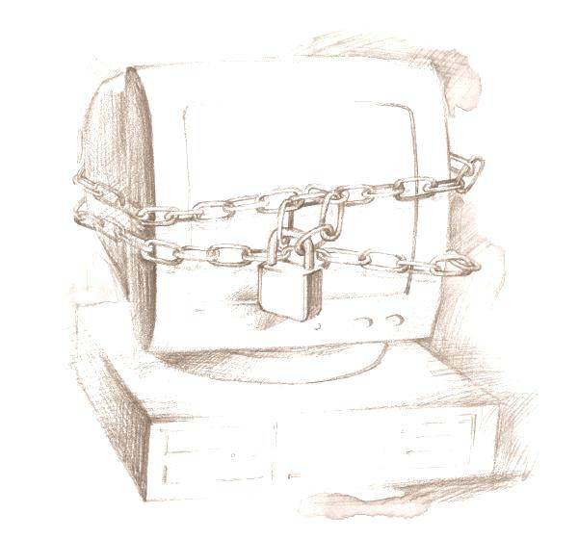
The Security Rule
A CLOSER LOOK AT THE SECURITY RULE
The Security Rule applies to health information in
electronic form
Establishes standards for the security of electronic protected health information (e-PHI) in order to protect the confidentiality, integrity, and availability of the e-PHI the covered entity collects, maintains, uses, or transmits

Slide 31
The Security Rule
(Safeguards)
The goal of the Security Rule is to provide for the confidentiality, integrity, and availability of the electronic health information (e-PHI) under the control of the Covered Entity
  Confidentiality means the data or information is not made available or disclosed to unauthorized persons, processes or devices
  Integrity refers to the fact the data or information has not been altered or destroyed in an unauthorized manner
  Availability means the data or information is accessible and useable upon demand by an authorized person
E-PHI is protected health information that is stored or transmitted in electronic form. Examples of commonly encountered e-PHI include, but are not limited to:
  PHI that is stored on memory devices such computer hard drives, shared drives, magnetic tape, and portable media devices (e.g., flash memory sticks, digital memory cards, CD-ROM’s, DVD’s, cloud storage, portable hard drives, etc)
  PHI that is stored in retained memory of medical devices and medical equipment
  PHI that is transmitted via e-mail, internet, intranet, private networks, leased lines, dial-up lines, or computer- based facsimile programs
The Security Rule requires the MTF to:
  Conduct information security risk assessments (the AFMS currently uses OCTAVE® )
  Protect against any reasonably anticipated threats and hazards to the security or integrity of electronic PHI
  Protect against reasonably anticipated uses or disclosures of information that are not permitted by the Privacy Rule
  Select and implement the technologies and practices most appropriate for the size and operational complexity of the facility
  Maintain ongoing management of identified risks to the confidentiality, integrity and availability of e-PHI
30

Slide 32
The Security Rule
(Safeguards)
Regularly review information systems activity for evidence of unauthorized access, unusual activity, and tampering
Conduct security awareness training to:
  Educate the workforce regarding individual roles in protecting against, identifying, and reporting malicious software
  Educate the workforce regarding recognition and reporting procedures for suspicious activity and attempts at unauthorized user access
  Educate the workforce regarding security procedures for password management
These requirements are achieved through the Air Force’s Information Assurance training program that all workforce members complete annually to maintain systems access
Compliance with the HIPAA Security Rule is largely transparent to the majority of Air Force Medical Service personnel; this is due in large part to the Air Force’s robust Information Assurance program which aligns with many of the Security Rule requirements
Good Security practices include things such as:
  Not attempting to access PHI in an unauthorized manner
  Not sharing passwords or allowing another individual to use your account credentials
  Not adding or removing hardware and software to/from AFMS computer systems
  Lock or log-off computer systems when unattended
  Never remove e-PHI from the facility without first clearing with the HIPAA Privacy or Security officer
  Minimizing PHI stored on shared drives and ensuring appropriate safeguards and access controls are observed

Slide 33
The Security Rule
(Safeguards)
As previously described in the section pertaining to the Privacy Rule, safeguards help ensure the confidentiality, integrity and availability of health information by protecting the data from internal and external threats
  Safeguards are required to reduce the risk of
    Improper access or destruction of PHI during storage
    Unauthorized interception or alteration of PHI during electronic transmission
  Safeguards fall into three broad categories (see examples below):
Administrative: These are formal practices to manage the selection and execution of security measures to protect data and the conduct of personnel in relationship to the protection of data
Physical: As the name implies, these are physical protections and activities that provide protection to computer systems and related buildings and equipment from fire and other natural and environmental hazards, as well as from intrusion. This can include locks, keys, safety devices and administrative measures to control access to computer systems
Technical: These safeguards utilize technologies to protect electronic protected health information and control access to it.
ADMINISTRATIVE | PHYSICAL | TECHNICAL
Operating procedures (MDGIs) for: Access controls Internal audits Personnel screening Training Risk analysis Sanctions (discipline) | Facility access controls such as cipher locks, restricted access areas Workstation Security; inventory control Hardware and software accountability Data backup and storage Device and media controls | The control and monitoring of individual access to the information Automatic screen saver and automatic time-out (log off) Measures to prevent unauthorized access to data, including audit trails, and event reporting Use of PKI encryption

Slide 34
Putting It All Together
APPLICATION OF
PRIVACY AND SECURITY PRACTICES IN THE WORKPLACE

Slide 35
Putting It All Together
Privacy and security practices must be fully integrated
  It is difficult, if not impossible to establish privacy without some form of security, even if the security is as simple as a locked drawer
  It is possible to establish security without privacy, but without privacy guidelines, we don’t know what needs to be secured, or when and how to allow access to the secured information
SECURITY
HIPAA
Compliance in Daily Activities
PRIVACY
=

Slide 36
Putting It All Together
Daily activities - best practices
  Know who you are talking to
    Validate the recipient's identity and their need / authorization to know the information before you speak about, or provide access to information
    Do not discuss the health status of beneficiaries with anyone unless they have a specific and authorized need for the information
  Challenge individuals in the building if they do not have a facility badge visible
    Make sure that casual visitors can’t wander into areas in which clinical or billing information is kept
  Never talk with the media or convey information to anyone “off the record”
  Individuals who work with Protected Health Information are given access to it on a minimum necessary/role- based access
    You are allowed to access Protected Health Information only as required to do your job
    Never “Surf” of “Snoop” for health information in CHCS, AHLTA, ICDB, or paper records
    Your passwords are for your use only. Do not share your passwords with anyone else. If you suspect that someone has attempted to use your password, report this immediately to the MTF Security Officer or Privacy Officer
  When leaving your area, even for just a moment, remove your CAC card and lock your computer so that no one else may use it in your absence
  Be sure to secure PHI on your desk and surrounding area when you leave your work area
  At the end of the duty day, PHI must be locked in a secure drawer or other container
  Do not leave unattended PHI on copiers or printers, especially when printing to a networked printer that is in a common area
  Do not use a speaker phone when discussing PHI
  Do not discuss PHI in hallways or other open areas

Slide 37
Putting It All Together
E-Mail
  Do NOT use e-mail to conduct provider-to-patient healthcare communications
☞ Exceptions: AFMS approved Secure Messaging applications and Corporate Dental Application (CDA)
E-Mail containing PHI must be protected in accordance with HIPAA and Air Force Messaging guidelines
  Protect the information from unauthorized disclosure, loss, or alteration through use of PKI encryption and digital signatures IAW AFI 33-332 and AFI 33-119
  Place the term FOUO in the subject line
  Place the appropriate HIPAA warning banner at the beginning of the e-mail message
General Safeguards for FOUO e-Mail
  Never send or forward e-mail containing PHI outside the “.mil” domain
  Never send or forward e-mail containing PHI to group (organizational) mailboxes or distribution lists unless the mailbox has a valid encryption certificate and each recipient has a need for, and the authorization to receive the information for all those visible
  As an additional safeguard, password protect attachments when possible
  Double check the recipient’s address before hitting the “send” button to ensure the address is correct, and that all recipients have a valid need and authorization to receive the content of the message
Purchasing or implementing new information management systems and medical equipment
  Always consult with the MTF HIPAA Security Officer when considering the purchase or implementation of new information management systems or other medical equipment that will store or transmit e-PHI
  Security Rule considerations must be addressed early in the planning process to ensure all functionality and compliance requirements are properly assessed and documented to avoid delays in bringing new systems on line

Slide 38
Putting It All Together
Internet, shared drives, and Social Media
  Never transmit any confidential information, including Protected Health Information, over Internet newsgroups, chat rooms, or other forums
  Do not use shared (common) drives to store or transmit PHI unless specifically approved by the MTF HIPAA Privacy and Security Officer
  Never disclose PHI on social websites; remember PHI comes in many forms, to include full face photographs
  Do not use commercial applications such as collaborative calendars, web-based applications, and cloud storage to store or share information, or to coordinate official business
  If you notice any suspicious activity, report it immediately to the MTF Security Officer or Privacy Officer
Portable devices
Portable media containing PHI must be protected and accounted for at all times
  Always coordinate with your MTF HIPAA Privacy Officer or Security Officer before removing PHI from the facility
  Portable media containing PHI MUST be encrypted and properly safeguarded
  Never leave a laptop or other portable media containing PHI unattended in your vehicle or other area out of your direct control
Digital cameras
  Cameras approved for clinical use must be secured when unattended
  Ensure memory cards are accounted for and properly “wiped” when data is no longer needed

Slide 39
Putting It All Together
Destruction of PHI
  Any documents or media containing Protected Health Information must be disposed of in a manner that will prevent accidental disclosure of the Protected Health Information to unauthorized individuals;
  Information must be unusable, unreadable, undecipherable …
    Shredding is the best method for paper
    Placing paper PHI in a locked FOUO container maintained by the Wing Recycling Program is an acceptable method of disposal
    Cut or break DVDs/CD-ROMs into two or more pieces and place in separate bins or burn DVDs/CD-ROMs in accordance with AF SSI 5020
    NEVER, NEVER, NEVER place PHI in an unsecured recycle bin or trash can
MTFs that participate in the Wing Recycling Program must establish a BAA with the recycling program to ensure the proper safeguarding and disposal of PHI placed in the FOUO recycle bins

Slide 40
Putting It All Together
Breach of information
  As an entity within the Federal Government, the Air Force must observe the requirements of DoD 5400.11-R, Department of Defense Privacy Program as pertains to safeguarding and reporting breaches of Personally Identifiable Information (PII).
    Identifiable medical information is considered PII by definition, and therefore subject to the safeguards and reporting requirements identified in DoD 5400.11-R
  As an entity subject to HIPAA, the AFMS must also comply with the HIPAA breach reporting requirements
  The DoD and HHS definition of a breach are shown below:
A breach can be intentional or unintentional
Common examples of breaches include:
  Providing or allowing access to PHI by unauthorized individuals
  Loss or theft of a laptop, portable hard drive, or other media containing PHI or PII
  Mailing, e-mailing, or faxing PHI to the wrong address
  Electronic transmission of PHI through unsecured channels
If you suspect a breach has occurred
  Secure unattended PHI (if applicable)
  Immediately notify your HIPAA Privacy Officer
  Do not delay reporting! The Privacy Officer will evaluate the circumstances of the event and initiate appropriate action steps if a breach has occurred
NOTE: Breach reporting is a high-visibility issue within the DoD. You will never be faulted for reporting a suspected or actual breach – when in doubt, always notify the HIPAA Privacy Officer; they will sort it out!
Protected Health Information (HHS)
Breach means the acquisition, access, use, or disclosure of PHI in a manner not permitted under subpart E of this section (aka the Privacy Rule) which compromises PHI security or privacy. For purpose of this definition, “acquisition, access, use, or disclosure of PHI in a manner not permitted under the Privacy Rule” is presumed to be a breach unless the covered entity or business associate, as applicable, can demonstrate that there is a low probability that the PHI has been compromised based on a risk assessment
Personally Identifiable Information (DoD)
Actual or possible loss of control, unauthorized disclosure, or unauthorized access of personal information where persons other than authorized users gain access or potential access to such information for an other than authorized purposes where one or more individuals will be adversely affected. Such incidents also are known as breaches

Slide 41
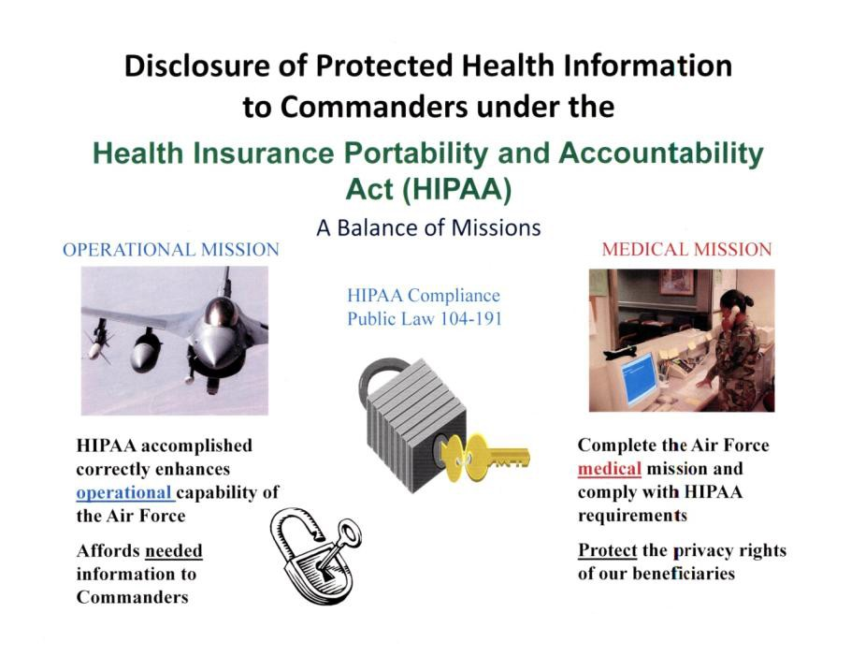
Putting It All Together
HIPAA recognizes the military’s unique needs and allows the MTF to disclose PHI to appropriate military command authorities under specific and limited circumstances
  Access is only granted to the appropriate military command authority or their designee
  The principal of “minimum necessary” must be observed
  Disclosure of PHI to commanders is a delicate balance between ensuring the
individual’s privacy and providing the commander with the necessary information to effectively discharge their responsibilities
  Commanders are not allowed to receive information pertaining to:
    Service members who are not under the commanders authority
    Family members of service members
Examples of reasons appropriate military command authorities may receive health information
  To determine a member's fitness for duty
  To determine a member's fitness to perform any particular mission, assignment, order, or duty, including compliance with any actions required as a precondition to performance
  To report on casualties in any military operation or activity
  To carry out any other activity necessary for the proper execution of the mission of the Armed Forces
40

Slide 42
Putting It All Together
The Commander Designee Process
  Verification of identity is required before releasing PHI to commanders or their designee
  Deputy/Vice Commanders and First Sergeants are considered designees by virtue of position (AFI 41-210)
  All other designees must be appointed in writing for a specified period of time and for a specified purpose
  The MTF HIPAA Privacy Officer is responsible for establishing local procedures regarding the commander designee process, to include:
    Procedures for verification of identity and authority to receive the requested PHI
    Procedures to ensure routine disclosures of PHI such as appointment rosters, PIMR reports, and quarters notifications are only released to authorized personnel
    Procedures for disclosure accounting
Communicating with friends and family
It is permissible to communicate with family members and other individuals identified by the patient.
In situations where the patient is not present or is unable to give specific permission, the MTF can exercise professional judgment in communicating with family, friends, and other individuals if it is deemed in the best interest of the patient or if it can be reasonably inferred that the patient would not object
Communications and Treatment of Minors
  Parents generally have the legal authority to make health care decisions about minor children; thus making them the personal representative of the child
  There are exceptions to the parent acting as the minor child’s personal representative
    When state law allows a minor to consent for a particular health service, the minor is acting as his/her own personal representative for that particular episode of care
    When a court or other law authorizes someone other than the parent to make treatment decisions for a minor
    When a parent agrees to a confidential relationship between the minor and the physician

Slide 43
Putting It All Together
When a provider reasonably believes in his or her professional judgment that the child has been or may be subjected to abuse or neglect, or that treating the parent as the child’s personal representative could endanger the child
Military family members often reach the age of majority at 18 years, but under certain circumstances may remain a dependent of their military sponsor for several years (determine dependency through DEERS or with Military Personnel Flight). Despite his/her dependent status, the family member becomes his/her own personal representative once the age of majority is reached
☞ Always consult with your HIPAA Privacy Officer regarding minors, as rules regarding treatment and communications with minors vary by state and OCONUS region

Slide 44
Conclusion
This concludes the Air Force Medical Service core training requirements for HIPAA Privacy and Security. Please contact your facility’s HIPAA Privacy Officer or Security Officer if you have questions on the content of this presentation, or would like additional information on a particular topic.
Your facility will provide additional training as necessary to address local policies and procedures, and role-based training requirements.
Please return completed HIPAA training form attached.

Slide 45

Health Insurance Portability and Accountability Act
HIPAA
Please Print this Slide, Sign & Date:
I have reviewed the slides of this presentation and agree to abide by the KMC HIPAA Guidelines.
Signature:_______________________________ Date:__________
Printed Name:____________________________
I

