Slide 1
UMC Annual Regulatory Review for Students
2025

Slide 2
Our MISSION & VISION
MISSION
Health, care, and education beyond extraordinary
VISION
University Medical Center New Orleans will be a leading world-class academic medical center and the destination of choice for exceptional health care.

Slide 3
MISSION, VISION, CORE VALUES
Our VALUES
We bring heart and soul. We're in it together. We give a little extra.

Slide 4
Code of Ethical Behavior
To do the right thing,
At the right time,
In the right place,
For the right reason.
You can reach out to the Ethics Committee 24 hours a day/ 7days a week by calling the hospital operator at 702-3000.

Slide 5
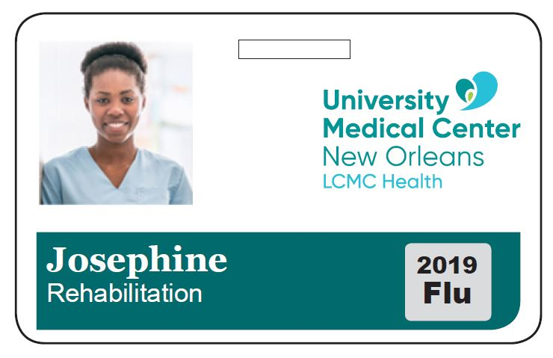
ID BADGES
Your hospital or student ID must be worn above the waist and in plain view at all times while on duty.
If you are on hospital property but not on duty, do not wear your ID.
Do not alter the badge in any way. Do not apply pins or stickers (unless approved ex; flu sticker) to the ID badge.
If your ID badge is lost/missing for 12 hours or more, report it to Hospital Police at 702-3108.

Slide 6
Appearance Code Policy LCMC 406
All physicians, students, contract workers, volunteers and vendors shall present a neat and clean appearance and dress in a manner appropriate for a healthcare environment.
No denim, shorts or revealing clothing may be worn.
Hair color, makeup, false lashes and nails must be professional and not distracting in color or design. Facial hair must be neat and well-groomed.
Jewelry must not be distracting or dangerous to patients or staff. No open gauges are allowed in ears.
Tattoos are to be covered while on duty.
Piercings in any visible area other than ears are not permitted or must be covered while on duty.
Hair coverings are not allowed except for religious or medical reasons; any headwear must follow department and/or safety standards.
Any style or electronic accessories are not permitted in patient care areas. Example: hats, sunglasses, video glasses headsets/earbuds (Bluetooth or wired), etc.
You may have a department specific dress code, review with the supervisor in your department.

Slide 7
Tobacco & Drug Free Workplace
Smoking and the use of smokeless tobacco products are prohibited on the UMCNO campus as well as all passageways, parking lots or within 0.5 miles of these areas.
It is prohibited for patients or visitors to smoke on UMC property. For their safety patients should be encouraged to remain within their designated units and not leave units.
It is prohibited for providers, staff, students, vendors and volunteers to smell of smoke in any UMCNO owned or operated facilities or buildings.
  UMCNO is a drug-free, alcohol-free, tobacco-free, vape-free workplace.

Slide 8
Brief Off-Unit Absence (One Hour or Less)
As part of the admissions process, patients are provided a copy of UMCNO’s Patient Handbook. Each patient should notify staff before leaving their Patient Care Unit. Failure to do so may result in the patient losing their inpatient bed and being discharged Against Medical Advice (AMA).
The following guidelines should be followed for patients requesting a brief off-unit absence:
A brief off-unit absence does not require a provider order.
Each patient is required to notify staff before leaving their Inpatient Care Unit.
Unaccompanied Minors (under age 18) are not allowed to leave the inpatient Care Unit. Parents must notify staff before accompanying a minor patient off their inpatient Care Unit. Failure to do so may result in the patient losing their inpatient bed and being discharged AMA.
Patients who are off the units unsupervised for more than 1 hour may be discharged AMA with a MD order

Slide 9
Send the RIGHT Message
DIMENSION | FACE-to-FACE | OVER THE PHONE
VERBAL/CHOICE of WORDS | 7% of what people believe is based on the words they hear | 13% of what people believe is based on the words they hear
VOCAL/TONE | 38% of what people believe is based on how the words are spoken | 87% of what people believe is based on how the words are spoken
BODY LANGUAGE | 55% of what people believe is based on what people see in the communicator’s body language | N/A

Slide 10
Our Customers
External
  Anyone outside the organization that has a choice about where to go for healthcare services. If they do not like our product or service, they will take their business elsewhere.
Internal
  Anyone within the organization that depends on YOU to help them provide a service to our external customers.

Slide 11
Customer Needs
External
  Respect
  Courtesy
  Communication
  Assistance
  Understanding
  Responsiveness
  To be heard
  Relief from symptoms
  Relief from fear
  Positive Outcomes
Internal
  Respect
  Courtesy
  Communication
  Assistance
  Understanding
  Responsiveness
  To be heard
  Purpose
  Worthwhile work
  Make a difference
Both external and internal customers have essentially the same human needs.
However…
Until we can provide care and service that meets these needs on an internal level, we will never be able to take care of our external customers’ needs.

Slide 12
AIDET: 5 Steps to Achieving Customer Satisfaction
AIDET is a framework for us to communicate with patients and families, as well as with each other to reduce anxiety and improve perception of care and service.
By nature, healthcare is a reactive profession.
AIDET allows us to be proactive as we seek to share our knowledge and experience, keeping people informed as we perform tasks that are common to us, but may be uncommon to them.

Slide 13
AIDET
A: Acknowledge
Greet people with a smile and use the name and or title preferred by the patient, when possible.
Use eye contact and body language that says “I care”.
Attitude is everything. Create a lasting impression.
I: Introduce
Introduce yourself to others politely and with a smile.
Tell them who you are and how you are going to help them.
Escort people where they need to go rather than pointing or giving directions.
D: Duration
Provide an estimate for how long something will take.
Keep in touch to ease waiting times.
Let others know if there is a delay and how long it will be.
E: Explanation
Explain, in order, what will happen & in language the customer is comfortable with—do not use medical jargon.
Advise others of what you are doing, how procedures work and whom to contact if they need assistance. Communicate any steps they may need to take.
Ask, “Is there anything else I can do for you?”
T: Thank You
Thank somebody. Foster an attitude of gratitude. Thank people for their patronage, help or assistance.
Thank the external customer for choosing UMCNO.
Thank the internal customer for helping/ assisting you.

Slide 14
In Person
Use the 10/5 Rule
  At 10 feet
    Make eye contact and smile.
  At 5 feet
    Say “Hello”, “Good morning/good afternoon.”
    Is this an opportunity? Does something look wrong? Does someone look lost?
      NO: move on
      YES: approach the customer; introduce yourself and ask how you can help.

Slide 15
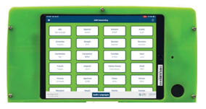


Language Services tip sheet
AMN Healthcare Languages is the Interpretation Services for LCMC Health.
Audio Interpretation Services
Phone Number: 877.426.1255 to reach an audio interpreter in all languages 24x7x365.
Provide your name and account: ACB Clinic, Emergency or University Medical Center
Provide your department
Provide medical record number of patient
Inform interpreter when finished with call
This can be used on any phone in the facility
Three-way medical interpretation calls are initiated through the phone
Interpretation Carts with iPad
iPad passcode to log into iPad is 002000
Press the green AMN app on the iPad
Provide your name and account:
ACB Clinic, Emergency or UMC Medical Center
Provide your department
Provide medical record number of patient
Main Features:
ASL (American Sign Language) is available through video interpretation.
If video interpreter is not available within 2 minutes, you will be automatically connected through to an audio interpreter.
White Board: interpreter can type and display a word or phrase in the native language if the patient needs to read it (i.e. a medication name or medical procedure).
Video Privacy feature available for patients who request privacy.
  Tap the iPad screen to display the camera at the bottom of the screen
  Tap a second time when ready to display video with the patient.
Languages not listed on the iPad menu can be accessed using the Audio button on the iPad.
3 Minute Training Video with additional features is embedded in the application. Press the Menu link in the upper right hand corner, then press Support and Training Video.
Past session information, including interpreter’s ID, may be accessed through the Menu link.
Device Care: Use the Gray Top Sani Cloth Wipe sanitizers for cleaning.
AMN Customer Support for technical issues: 855.663.1231
22-16884-0114

Slide 16

Translation services: How to place requests
To submit request online for translation:
https://www.stratusvideo.com/stratus-word/
File should be either Word format or an Adobe InDesign packaged file (see Creative Services for this type of file). If you do not have the file formats above, vendor can provide a quote, but if vendor has to retype your entire text into a Word document to estimate the English word count, that will incur an additional expense.
Submit request online
(see link above)
Obtain quote and estimated turnaround.
Approve quote.
Project delivered within turnaround time.
Receive your invoice within 30 days.
22-16878

Slide 17
Health Literacy
Listen
Treat patients and families with respect.
Explain information in ways the patient understands.
  Using translator services or preferred language
Welcome and encourage any and all questions.
Teach back
  Ask patients to repeat back, explain and/or demonstrate the instructions given to them to ensure understanding.
    Wound care, dressing changes, injections
    Document these examples.
Explain all treatments and medicines before giving them.
Give patients the information they will need to take care of themselves at home.

Slide 18

Compliance
Follow the LCMC Code of Conduct, all standards, rules, regulations, & compliance policies.
Conduct all care & business with the highest ethical standards.
UMCNO Compliance - Contact Connie Madden.
Report any suspected compliance violations at compliance hotline
or 702-3532 or 1-855-9COMPLY (855-926-6759).

Slide 19

HIPAA
Health Insurance Portability & Accountability Act
  Law that protects the confidentiality, security, and privacy of patient information.
  There are significant penalties for healthcare providers who violate HIPAA regulations including a patient’s privacy.
  Establishes NEED TO KNOW:
    If your job function does not require you to know about the patient or the patient’s information while you are clocked in, hospital policy & the law says you may not access the patient’s information.
    Every keystroke in Epic is recorded, & your access into Epic is auto-monitored by software, by LCMC/UMC & will alert your Compliance Officer of any suspicious access into any patient’s electronic medical record.

Slide 20

HIPAA
Health Insurance Portability & Accountability Act
    Rental equipment used in patient care stores confidential patient information & must be return to Bio-Med, CMS or IT before being returned to the vendor to ensure all personal and private information is removed and equipment cleaned.

Slide 21


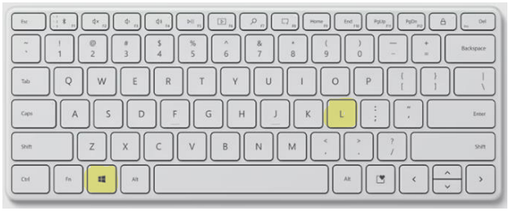
HIPAA
Health Insurance Portability & Accountability Act
    The single most important way to secure patient information is to LOCK your computer when you step away from it, even if you think it’s only for 10 seconds!

Slide 22
Dealing with the Media
Occasionally, you may be asked by members of the media about private and confidential patient information (PHI). If this happens, refer the person to the marketing department –
ext. 2-3769, or your supervisor.
  To prevent violating the laws of privacy and confidentiality, you may answer, “No comment” to any of their questions.
  If a media representative refuses to leave your department or continues to question you and other staff, contact hospital security.

Slide 23
Compliance: Bottom Line
You cannot access any patient’s record that contains PHI without a job-specific reason/ justification, or NEED TO KNOW.
This includes access to your family members’, friends’, or other employees’, PHI who are patients at the hospital.
Violations of UMCNO’s HIPAA policy will result in immediate termination of access, and possible termination of your employment.

Slide 24
Compliance
It’s EVERYONE’S job!
If you have any question or concern about something not being done correctly or properly, speak to your supervisor, director, or administrator, or call the Compliance Dept. at #2-3532.

Slide 25


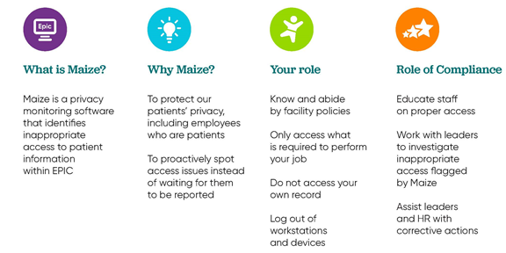

Slide 26
Louisiana Family Caregiver Act
The Louisiana Family Caregiver Act requires the hospital to ask admitted patients who will be caring for them when they go home. It can be anyone the patient designates.
The hospital must record the caregiver’s name, telephone number, and address in the medical record before discharge.
The designated caregiver is to receive all the home care education and instructions, along with the patient.
The patient may decline to designate a caregiver.

Slide 27
Service Animals
UMCNO allows the use of a service animal (unless it is a bird, reptile or cat) within the facility by a patient unless the patient is:
  receiving services that would not allow the patient to be in full control of the animal at all times
  if it creates a serious infection control issue.
Service animals accompanying visitors may also be allowed to access the facility.
Service animals are not allowed in ICU units, the ED rooms, areas where patients are immunocompromised, isolation rooms, food and medication preparation areas, areas where sterility is required, diagnostic areas, operating room, or dialysis unit.
Emotional support animals are NOT service animals and are never allowed at UMCNO.

Slide 28
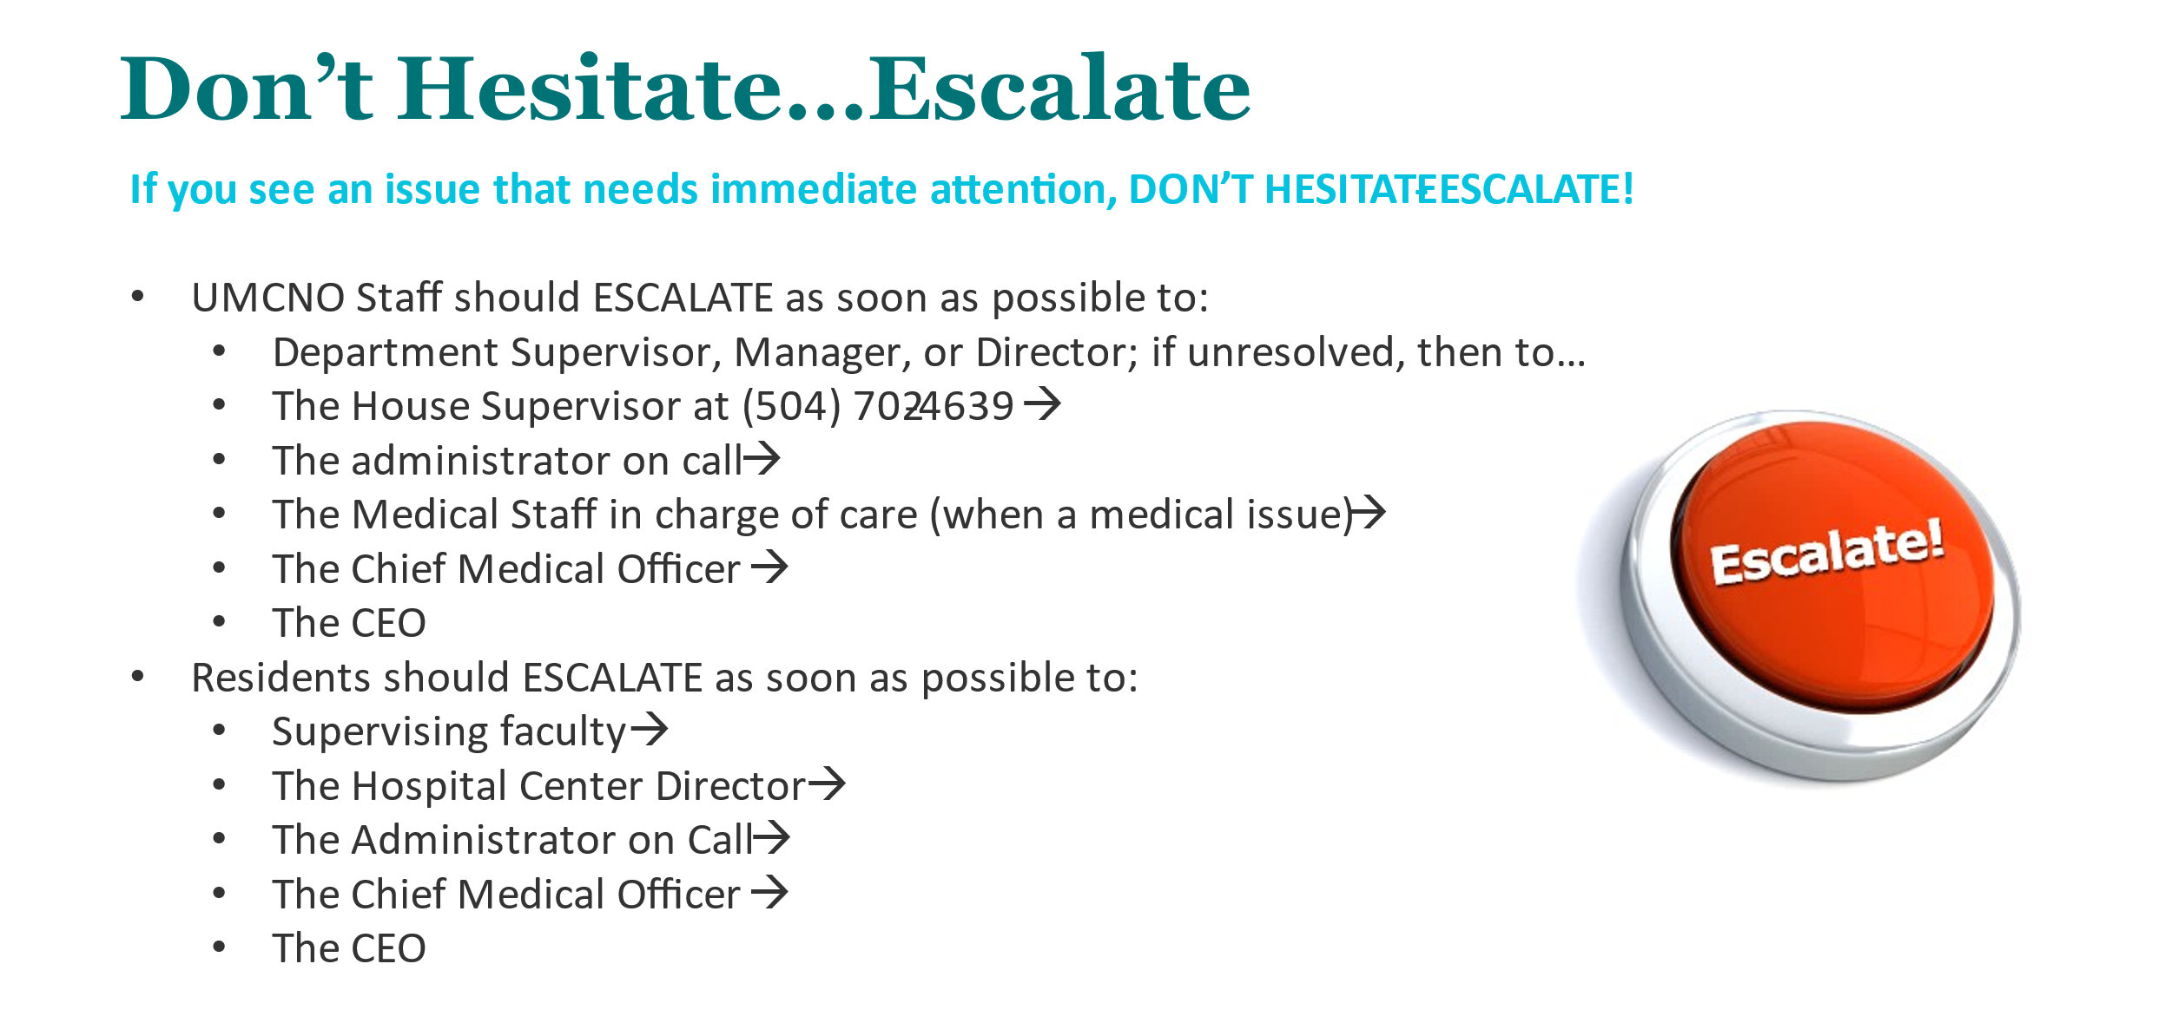

Slide 29

SAFETY
B-SAFE & Don’t Hesitate…Escalate Guidelines
It is everyone’s responsibility to help keep patients, visitors, volunteers, providers and staff SAFE.
Report any event that causes concern or could potentially cause harm, a medical error or near miss, prevents you from appropriately caring for a patient.
  You can report an event through the RL solutions icon located on a computer desktop screen or through the LCMC Intranet’s home page
  If you need immediate assistance, follow Don’t Hesitate…Escalate guidelines.

Slide 30
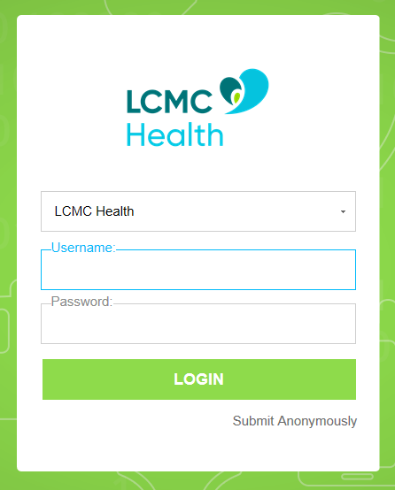
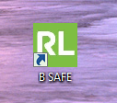
BSafe: Incident Reporting System
Icon found on all LCMC desktops
Username: john.smith
  Do NOT include @lcmchealth
Password: same as LCMC/Epic
Ability to submit anonymously

Slide 31
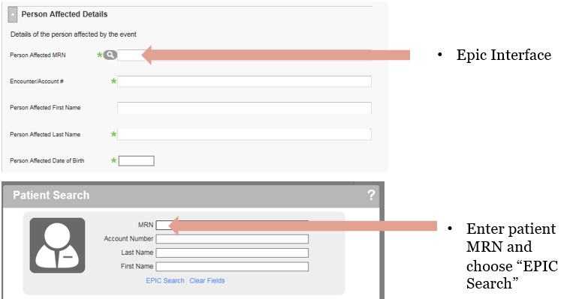
BSafe/Epic Interface

Slide 32
Code Red
In the immediate area of the fire: RACE
Rescue persons in immediate danger
Activate the alarm; call 2-5000; 702-5000
    Be sure to state the
      Building
      Floor
      Zone (if applicable)
      Room Number
      Your Name
      Type of Fire (i.e. mattress on fire)
Contain by closing doors
Extinguish or Evacuate

Slide 33
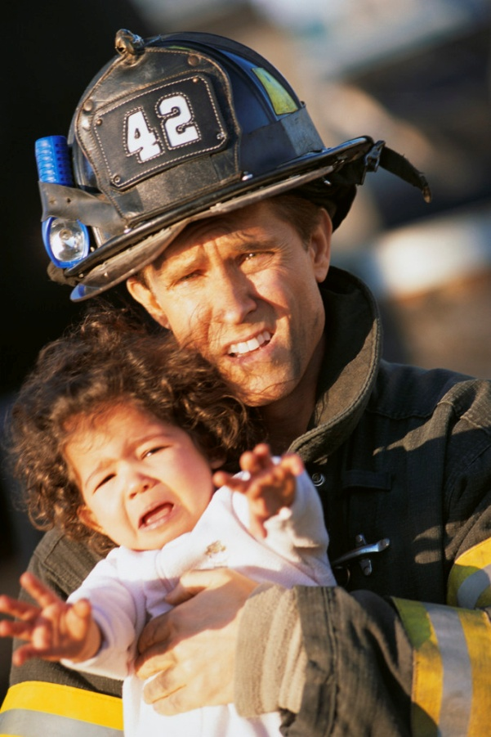
Code Red--RESCUE
Rescue anyone (this includes yourself) who is in immediate danger from the fire. Remove these people to the closest safe area, simultaneously notifying other staff of the fire and its location. Know where alternate exits are located.
Horizontal Evacuation: move everyone (from one smoke compartment to another) to an adjacent fire-safe area protected by fire/smoke barrier walls until the area is deemed safe by fire department officials or until further evacuation is necessary. All departments have maps posted showing the exits, location of fire/ smoke barrier walls, fire extinguishers, and fire alarm pull stations. Become familiar with your area of work.
In a hospital setting it is not always necessary to evacuate every patient in the case of fire. If you are in an area that is above, below or adjacent to the fire, “defend in place”:
1. Move patients into their rooms
2. Close all doors and windows
3. Wait for further instructions
Only the Chief Executive Officer may call for an evacuation of the entire hospital.

Slide 34
Code Red-Horizontal Evacuation

Slide 35
Code Red--Close/Contain
Confine the fire by closing all of the doors in and around the fire area. This will help keep fire and smoke from contaminating the exit paths during evacuation. It also helps to keep the fire to a much smaller area and aids in preventing it from spreading to other areas.
Areas with medical gases have shut off valves in the corridor serving the area. Only the department director, nurse managers or charge nurses are authorized to shut off medical gases during a fire in conjunction with Respiratory Services.

Slide 36

Code Red--Extinguish
Extinguish when the fire is smaller than a waste paper basket
If a fire is well developed, the best thing to do is close the doors around it and get out. Do not place yourself at unnecessary risk– your greatest value is as a rescuer, not as a firefighter.
ABC fire extinguishers may be used on most fires. All hospital fire extinguishers are ABC type.
  Operating rooms, MRI procedure rooms and kitchens have their own type of special fire extinguishers. You must be familiar in their use if you work in these areas.
To operate, remember “PASS”:
1. Pull the pin.
2. Aim the nozzle at the base of the fire.
3. Squeeze the handle.
4. Sweep from side to side at the base of the flame until the fire is
completely extinguished.

Slide 37
Electrical
Healthcare organizations should prepare to address power outages and other emergencies that may affect the electrical system. During a power outage, healthcare organizations must provide backup power through generators or Emergency Power Supply Systems (EPSS).
When generators are in use, critical patient care equipment should be plugged into appropriate generator-powered electrical outlets; they are color-coded red.
A utility failure can be an electrical outage, a large water or sewer leak, lack of heat or air conditioning, or similar event. If there is a utility failure in your area, staff are to immediately report it to Facilities Management at 702-2015. If the utility failure affects a large area of the hospital a Incident Command will set up and notification will be sent out as necessary.
▪
Inspect all electrical equipment before use; do not use if damaged or wet.
Plugs must have a 3rd prong.
Remove by pulling the plug, not the cord.
Only UMC electricians may open electrical panels and reset breakers.
Extension cords are not allowed.
Only UMC-approved electrical equipment may be used, including extension cords and power strips.

Slide 38
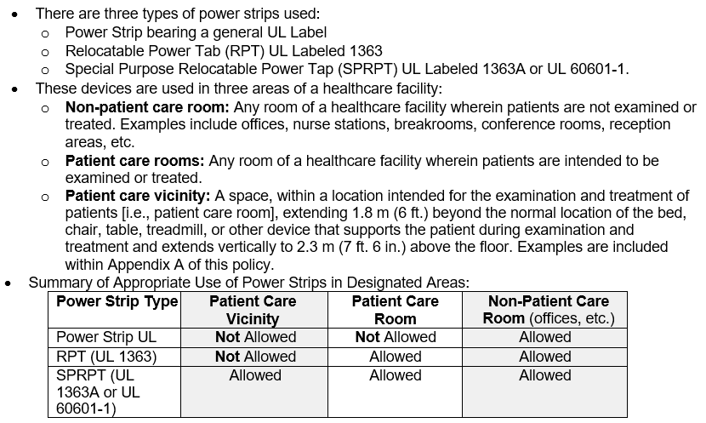
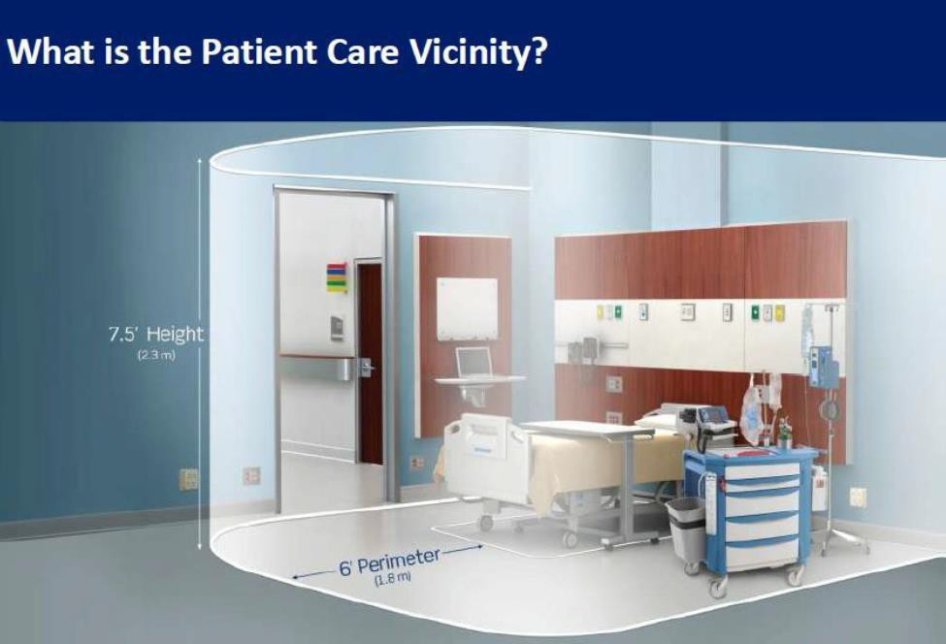
Power Strips & Extension Cords
Familiarize yourself with UMC Policy 4015- Use of Relocatable Power Tabs (known as power strips).
All power strips for use in patient care rooms are approved for use by the Biomedical Engineering Department before they are placed into service.

Slide 39

Hospital Public Safety
Everyone is responsible for a safe environment.
While at work everyone must wear an ID badge, above the waist and in plain view.
Report any unusual or unsafe situation to Hospital Police (702-3108).
Watch for and report any potential violence.
When entering a secure area, pay attention to your surroundings; do not allow unauthorized individuals to enter with or behind you.

Slide 40
Safety & Emergency Codes
Call 702-5000; 2-5000
There are 11 Hospital Emergency Codes:
Code Blue Respiratory/Cardiac
Code Gold Offender Escape Arrest
Code Black Bomb Threat
Code Pink Infant/Child Missing
Code White Violence/Security
Code Yellow External Disaster
Code Orange Hazardous Material Spill
Code Grey Severe Weather
Code Red Fire or Smoke
Active Shooter Active Shooter
Page Dr. Flight Elopement (PEC/CEC)

Slide 41
EMERGENCY
2-5000 / 702-5000
This is a dedicated line strictly used for emergencies.
Do Not Dial 2-3000 in an Emergency
This line goes to the switchboard which is prioritized by the phone system. Your call we be placed in a que and the answer will be delayed.
2-5000 is a separate line from the switchboard and is given prior from the Communication department staff.

Slide 42
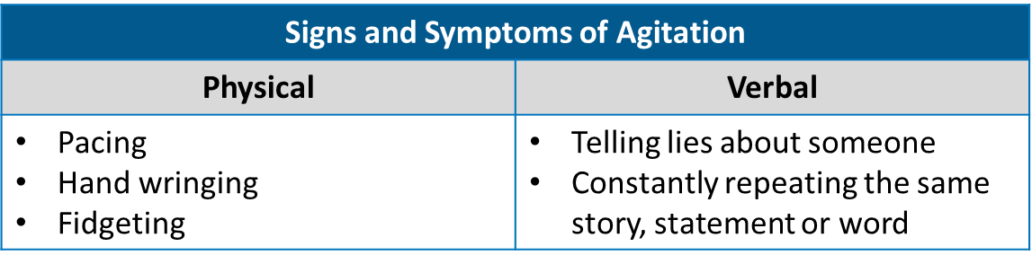
Codes
Code White: potential or actual violent situation
Physical or threatening violence, actual or potential, which can not be re-directed and escalating.
It is often preceded by warning signs, such as a heated argument, anxiety, agitation, pacing.
Domestic situations can result in violence at work; notify Hospital Public Safety if someone has stated that they are involved in such a situation.
Initiate de-escalation techniques early; do not wait until the situation becomes violent.
For patients with a history of violence, an FYI Code White flag is placed in the EHR to alert caregivers.
Before a situation with an agitated patient escalates out of control, try using therapeutic communication to calm the patient. Many times you can calm or defuse a situation by making patients aware of their behavior without putting them on the defensive. However, be careful about what you say and the way you say it. Your words and your tone can either resolve the situation or make it worse.
Call for help if needed. Hospital Public Safety can be called for assistance of suspected escalation.

Slide 43
Codes
Code Black: Bomb Threat
Tell operator “bomb threat report”; give the operator details
If you receive a call, pay attention to any details
Tell the caller the hospital is occupied, and this could result in injuries and death
Remain calm and notify your coworkers
Do NOT notify patients or families
Follow instructions of hospital leadership

Slide 44
Codes
Code Pink: Infant/child missing
Go to the nearest hospital exit
Watch for anyone leaving the hospital with an infant/child
Do not attempt to detain the person
Observe their appearance, vehicle and direction of travel; report all details to hospital police
Code Orange: Hazardous Material Spill
If you discover a hazardous chemical or radioactive spill, you should:
  Take measures to isolate the area to keep individuals away from the spill.
  Contact your supervisor or manager and describe the spill to him or her.
  Help locate information about the chemical using safety data sheets

Slide 45
Codes
Code Grey: Severe Weather
LCMC Disaster Services Policy
Your manager or supervisor will assign you to a team:
  Activation Team: works during the storm
  Recovery Team: reports back to work immediately after the Code Grey has ended; if you are on the Recovery Team, you must contact your supervisor within 24 hours after a storm passes.
  Not Activated Team: you must contact your supervisor within 24 hours after a storm passes. Prepare to return to work with return of normal operations and scheduling.

Slide 46
Codes
  Active Shooter: Active Shooter
A gun has been fired or is being used in a threatening manner or there is a hostage situation.
  Be prepared to tell the operator the location of the person carrying the weapon.
  Give the operator a description of the person and the actual weapon.
  Close all doors throughout the patient care area, including unit exit doors.
  RUN, HIDE, FIGHT
  Note: A gun in a bag or holster should be reported to Security at 2-3108.

Slide 47
Codes
Code Gold
  Offender Escape
  Employees secure in place.
  Patients, family and visitors shelter in place.
  Close all doors throughout the patient care area, including unit exit doors.
Page Dr. Flight
  Elopement of patient under:
    Physician Emergency Certificate (PEC)
    Coroner Emergency Certificate (CEC)
    Judiciary Commitment (JC)
  Reporting area give departing location and detailed description of patient.
  All others notify hospital public safety if patient is seen.

Slide 48
Safe Medical Device Act
Federal law says the FDA must be informed of any medical product causing or suspected to have caused a serious illness, injury, death or potential injury.
An MDR (Medical Device Report) 3500 is used to report:
  difficulty operating a device
  incorrect use
  adverse patient reactions/injury
  defective equipment

Slide 49
Defective Equipment
When a device is defective or appears to be malfunctioning:
  Immediately remove it from the patient care area.
  Tag medical equipment with a Biomed supplied repair tags. Contact Biomed for repair tags. Do not write “Broken” on paper and attach to the equipment.
  Take the equipment down to CMS or Biomed for repair or contact one of these offices and ask them to retrieve the equipment.
  Report using RL Solutions found on your desktop and on the intranet homepage if biomed equipment is involved in a patient related incident.
  Biomed services can be requested by contacting 2-3300.

Slide 50

Preventing Falls
A strong culture of safety is realized when everyone prioritizes their safety and the safety of their co-workers and patients.
Pay attention to your work area. Correct or report unsafe environmental hazards:
  Cluttered walkways
  Wet or slippery floors
  Uneven surfaces
  Poor lighting
Follow safety protocols.
  Fall Precautions –
    Yellow arm bands and yellow slipper socks are available.
    Patients should ambulate with assistance.
      Educate patients and family to call for assistance when ambulating.
    Beds in lowest position and bed alarms enabled.

Slide 51
Infection Prevention and Control
Perform hand hygiene
No eating or drinking in any patient care area or nurse stations
Do not come to work if you are sick
Mandatory, annual flu vaccination (Nov 1-Mar 31); otherwise, you must wear a surgical mask during flu season
Use standards precautions with every patient
Use Personal Protective Equipment (PPE) as indicated by hospital policy
If it is anticipated that there may be a chance of a blood/body fluids spill, you must also wear impervious shoes or shoe covers

Slide 52
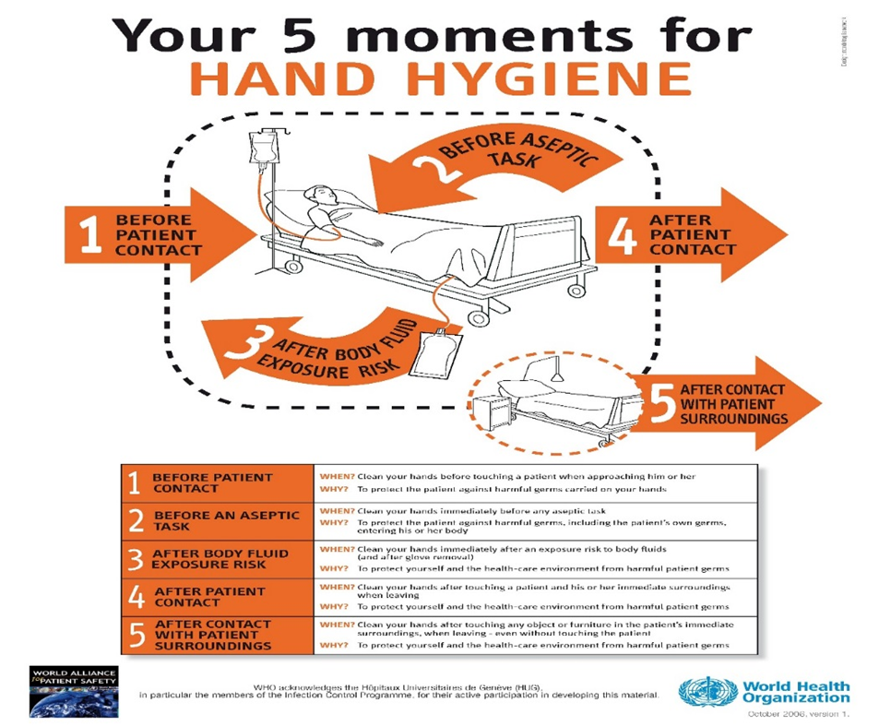
Hand Hygiene

Slide 53
Risk of Exposure
Actions that Most Often Cause a Contaminated Needle Stick or Sharps Injury
Activity | Worker Group Most at Risk
“Passing” activities in the operating room | Nurses, physicians
Starting an IV | Nurses, physicians
Giving injections | Nurses, physicians
Performing an IV flush | Nurses, physicians
Drawing blood for laboratory tests | Phlebotomist, nurses, physicians
Picking up sharps | All
Removing garbage after incorrect sharps disposal | Environmental services
Cleaning rooms after incorrect sharps disposal | Environmental services
Sorting and cleaning laundry | Laundry workers
Performing activities when tired | All

Slide 54
Protect Yourself
Treat all body fluids as if contaminated.
Identify risks of exposure (based on your job duties); always use safe work practices.
Use all safety devices as directed.
Use PPE if exposure is possible.
Never recap needles; dispose of in appropriate sharps containers.
When using sharps, be aware of those around you so you do not accidentally injure anyone else.
When sharps bins are ¾ full, call for a replacement.

Slide 55
What to Do if Exposed
Clean the area with soap and water
Tell your supervisor immediately
The supervisor in the department where the exposure occurred must obtain blood from the source patient and hand walk the blood specimens to the lab with the Source Needle Stick Form
The exposed employee immediately reports to the Emergency Department arrival desk for arrival and treatment
Before the end of shift, report the incident in RL Solutions
Follow up in Employee Health
Needle Stick Injury Protocol can be found on the UMC website under Employee Health Needlestick Protocol

Slide 56


Healthcare worker (HCW) blood and body fluid exposure - Protocol
Treat Site
  Wash the area with soap and water
  Flush mucous membranes with water
  Flush eyes with water or saline
IMMEDIATELY report the incident to Department Lead AND the House Supervisor
Provide the following information-
  Name of source patient
  Room where exposure occurred
  Date and time
  Exposed HCWs name, DOB and phone number
The House Supervisor assists, as needed, with source lab draw
Retrieves hospital source lab slip in office or on the Employee Health SharePoint website
Exposed HCW reports to the ED - Patient Access for registration
  Informs Patient Access this is an Employee Health injury
  Patient Access registers HCW as workers compensation insurance
  HCW is evaluated by a Medical Provider and treated, if indicated
Exposed HCW completes a B-Safe prior to end of shift. Please use the employee’s name for the “Person Affected and MRN” field on the B-Safe report.
Exposed HCW follows up with Employee Health nurse after ED visit or next business day to discuss status of exposure and if further follow up is required.
Contract staff follow up with employer/Educational facility after Employee Health visit.
Update Patient Access with workers compensation claim number within 5 days of injury/exposure to avoid self- pay.
Patient access contact email
UMC
UMCEHWorkersCompNotification@LCMChealth.org

Slide 57

COVID - 19
COVID hotline
Employee Health Hotline
(Mon-Fri, 7 am - 5 pm; closed weekend and holidays)
​ 2-6270 or 962.6270 (outside facility)
COVID -19 Updates can be found on the intranet
Report COVID-19 symptoms or possible exposures to employee health through the hotline listed above

Slide 58
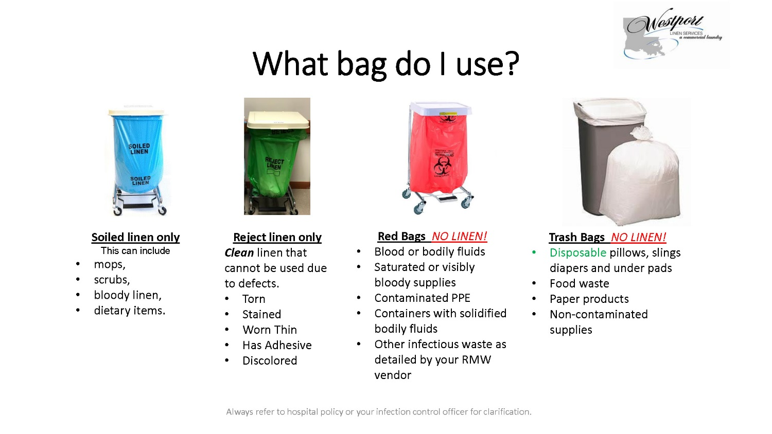


Which bag to use for linen?
Note: blue linen bags should be pulled from rooms each shift

Slide 59
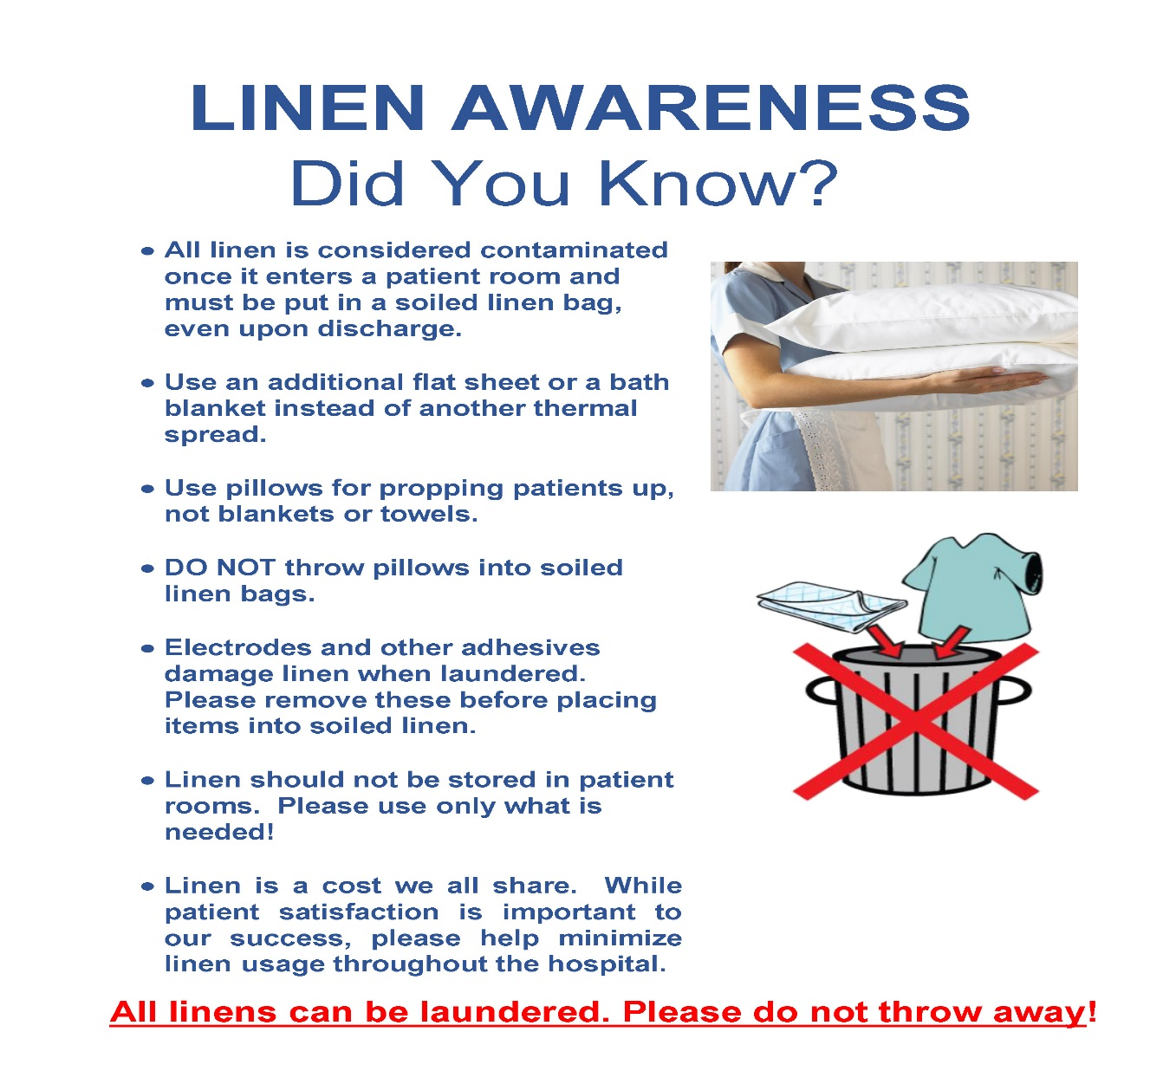
In 2023, the lost / discarded linen cost UMC $270,300

Slide 60
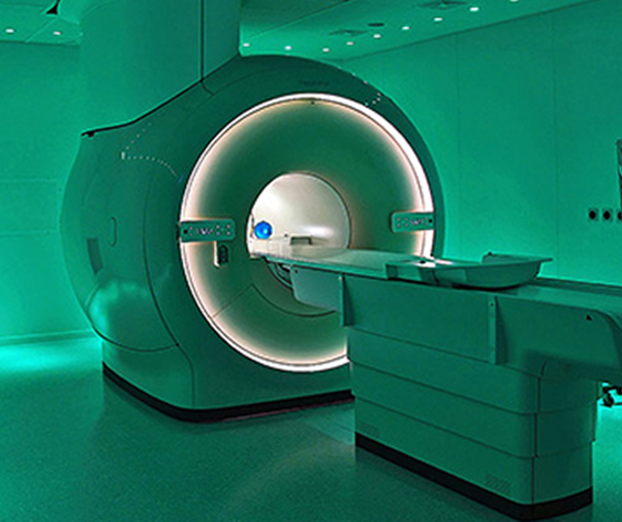
MRI Safety
Anything containing iron is to be kept out of the scan room either as equipment or present in the patient.
“When it doubt, leave it out!”
Serious or fatal accidents can occur if safety procedures are not followed.
Safety is an active process that requires that you are vigilant.
The MRI is not dangerous for patients or personnel if appropriate safety procedures are followed.

Slide 61
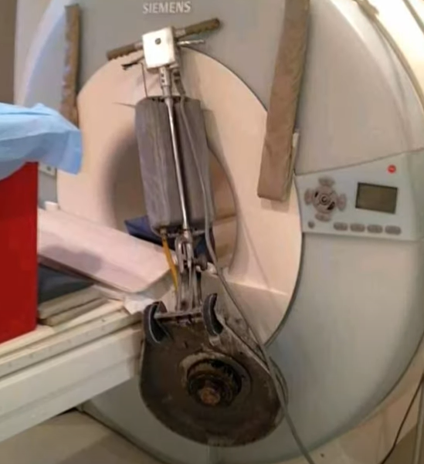
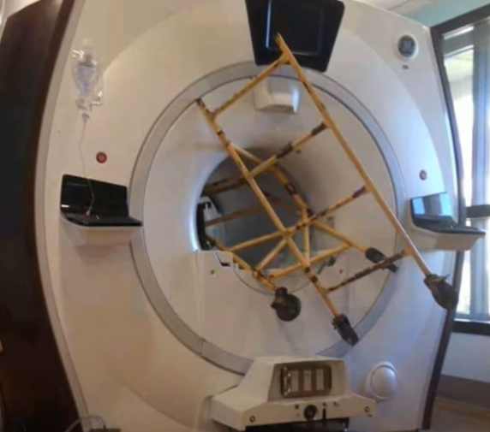
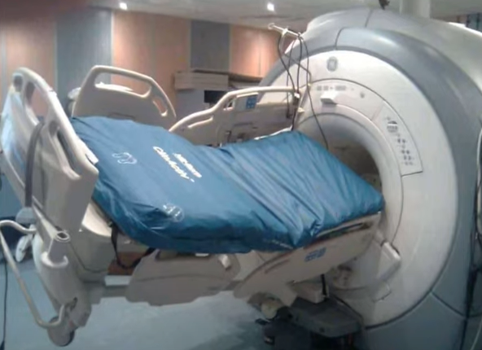
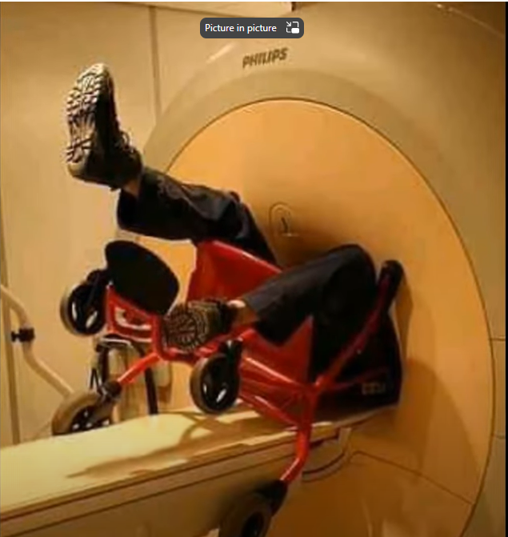
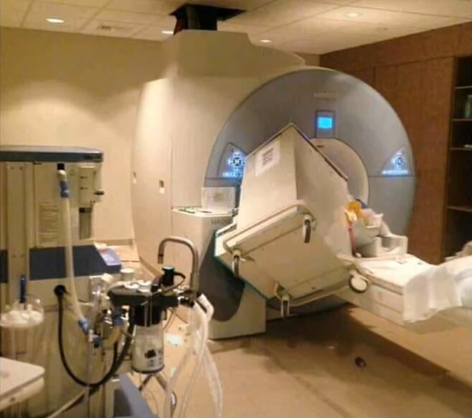
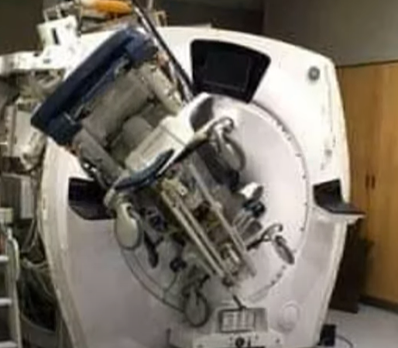
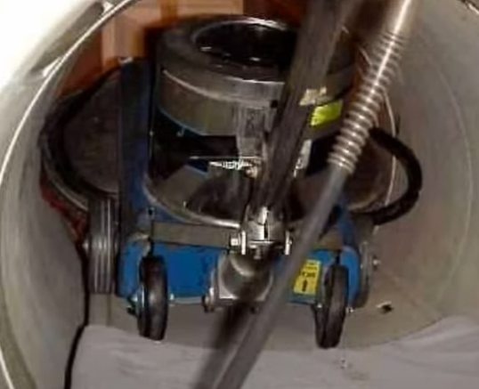
More Potential MRI Disasters….. Not only medical equipment
61

Slide 62
Compressed Gas Cylinder Storage and Handling
Special precautions are taken to assure the safe use, transportation, and storage
of compressed gas cylinders.
Serious accidents may result from the misuse, abuse, or mishandling of compressed gas cylinders.
Handle cylinders of compressed gases as high-energy sources and therefore as potential explosives.
Compressed Gas Cylinder Storage and Handling policy:
https://umccontracts.policymedical.net/policymed/anonymous/docViewer?stoken=82e0cdc9-f3d9-4a0f-a3c0-e9bd787b2d0c&dtoken=b1be8459-dea5-460d-9355-057797f6a277

Slide 63
Compressed Gas Cylinder Storage and Handling
A gas cylinder placed next to a patient’s bed and intended for use within a short time would is not considered as being in storage.
A cylinder of oxygen on an emergency code cart or a stretcher is also not considered as being in storage.
In these examples, the cylinder is “in use” and does not count toward the 12 total full E-sized cylinders stored.
Maintaining proper storage of medical gas cylinders also avoids confusion and delay if a full cylinder is needed hurriedly.
For medical gas storage in storage racks, partial and empty cylinders are segregated from full/unopened tanks. The racks are labeled as “full/unopened” and “partial/empty”. Any tank that is not “full”, i.e., needle in the green zone on the gauge, is placed in the “partial/empty” side of the storage rack.

Slide 64
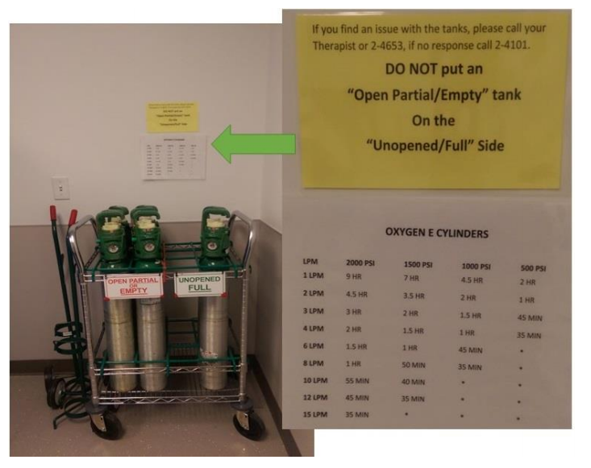
Compressed Gas Cylinder Storage and Handling
For medical gas storage in storage racks, partial and empty cylinders are segregated from full/unopened tanks. The racks are labeled as “full/unopened” and “partial/empty”. Any tank that is not “full”, i.e., needle in the green zone on the gauge, is placed in the “partial/empty” side of the storage rack.
One storage rack of no more than 6 E-type cylinders is marked “UNOPENED FULL CYLINDERS” for storage of unopened cylinders only. Most e-type cylinders indicate a reading of 2000 psi or greater as full.
One storage rack of no more than 6 E-type cylinders is marked “OPEN PARTIAL OR EMPTY CYLINDERS” for storage of partial and empty cylinders only. The placard sign on this rack will also state “PARTIAL > 500 PSI” and “EMPTY < 500 PSI” to define partial and empty designations.

Slide 65




Resources
Policies:
  · Under “Additional Resources”: Policy Medical, or
  · UMC Shortcuts folder: UMC Policies & Documents
Education/eLearning: TLC – “The Learning Center”
  · Employee Resources page
InTouch UMC Intranet
  · Employee Resources page
Mosby’s Clinical Skills:
  · UMC Shortcuts: Clinical Skills
Lexicomp (Drug Reference)
  · Inside Epic medical record (Resources tab), or
  · UMC Shortcuts folder (desktop)
Patient Education Materials
  · Lexicomp (preferred) inside Epic, or
  · Mosby’s Skills: Patient Education tab
Clinical Equipment Users Manuals
  · U drive (Clinical Equipment Users Manuals folder)
ePrivileges (to check physicians’ procedural privileges)
  · Inside Epic, “Resources” tab
Uptodate (Clinical Information)
  · UMC Shortcuts folder (Desktop)
ERP – Electronic Resident Procedures
  Can be found in Epic “Resources” tab

Slide 66

Thank you

