Slide 1
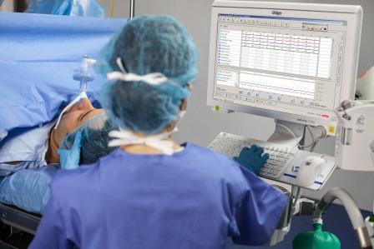
VA NOLA
Anesthesia Record Keeping: End User Guide
Intra Op
Notes:
1

Slide 2
Learning Objectives
  The anesthesia providers will demonstrate the following functions specific to their role:
    Logon Process
    Patient Selection / New Case
    Adding Environments
    Trending
    Action Buttons & Tool Bar Use
    Layout - Tabs & Pages
    Case Documentation
    Emergency Case Management
    Printing Record To CPRS/VistA Imaging
  The anesthesia providers will verbalize validation of system functions and methods to trouble shoot the system.
  The anesthesia providers will summarize understanding of the workflow processes developed for their environments.

Slide 3
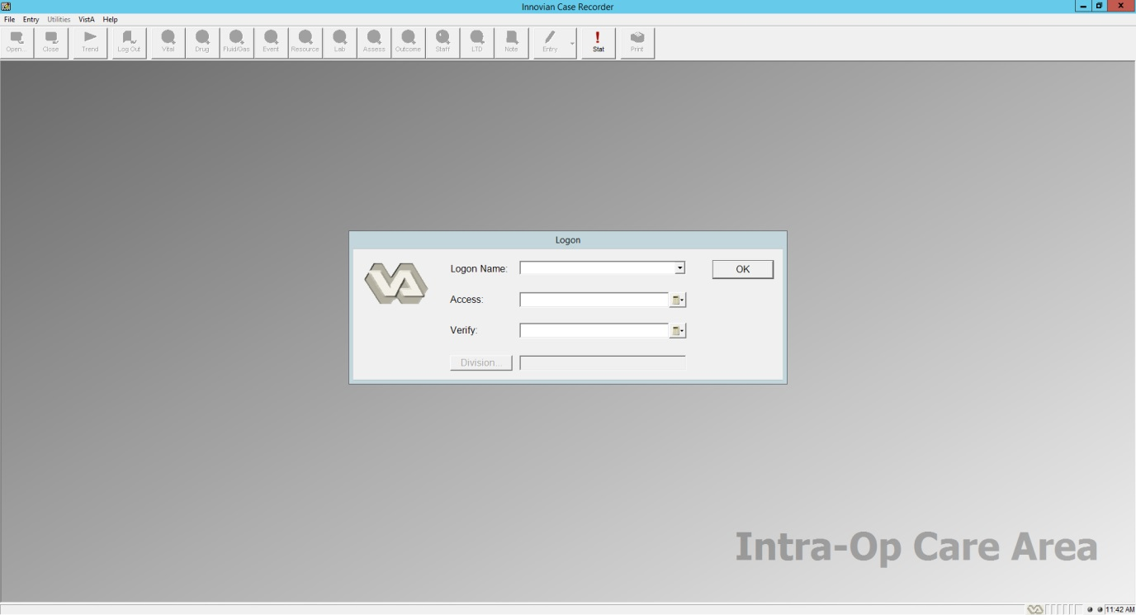
VistA Logon – New User
Upon opening the Innovian Anesthesia application, the user is prompted to logon with their VA provided CPRS access and verify codes.
Verify codes cannot contain the following special characters ; : ^ /\
No division should be selected.

Slide 4
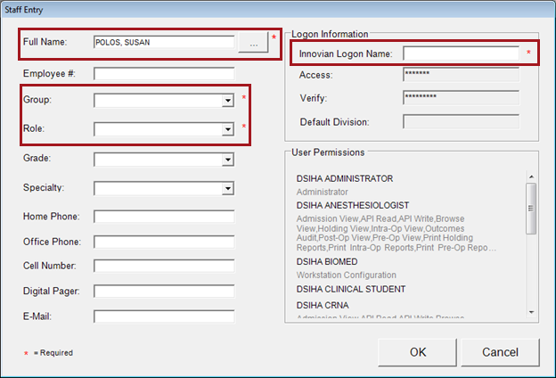
Adding a New User – Staff Entry New User
Logon Name should be Full Last name and first initial –(i.e. smithb)
Group should be CRNA or Anesthesiologist
Role should be PRIN. ANES for CRNA’s & Residents and ANES SUPER for Anesthesiologist
Notes:
With assistance from the clinical lead, the user can then fill in the appropriate information
Full name information
Create Innovian Logon Name – this should be based on the standard used by other Innovian users, such as Last Name, First Name; Windows Login Name
Role based on their licensure or function within the department.
Select the Staff Group – which tab their name should be found under
Click “OK” to finalize their Logon information.
In subsequent logins, they will Logon by entering their Logon Name, Access and Verify codes.
User rights within Innovian will be determined by the membership within the User Keys.
The user must be assigned to the key along with menu options within Vista prior to logging on to Innovian

Slide 5
VistA Logon – Unsuccessful Messages
When these message occur note that you are no longer integrated with VistA CPRS.
Any information that was updated or shared between the 2 application is no longer available.
Once re-connected, you will have access to labs, vitals, progress notes, and printing will again be available for use.

Slide 6
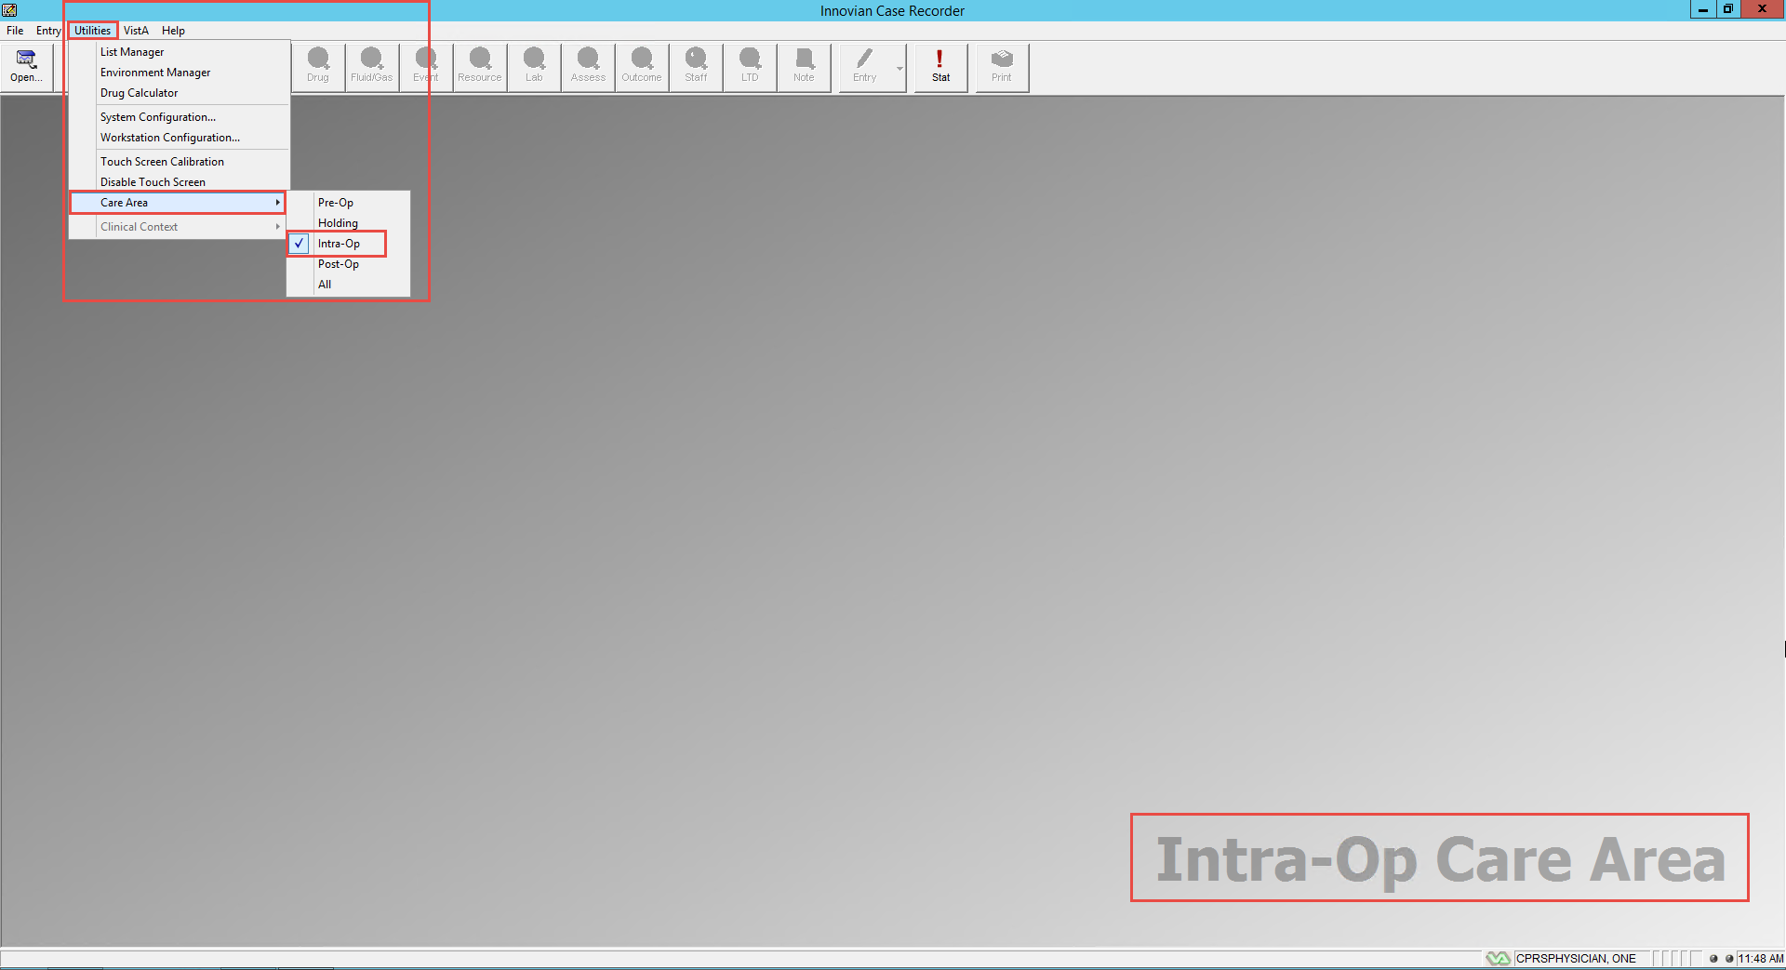
Using Care Areas -
MAKE SURE YOU ARE IN THE CORRECT CARE AREA
Setting the Care Area is telling Innovian where you want the patient’s physiological data and case information displayed.
The care area can be changed via the Menu - Utilities/Care Area

Slide 7
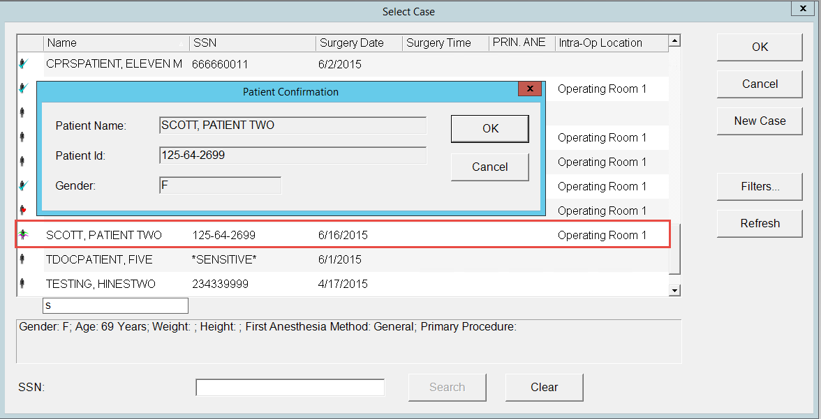
Case Selection
Select Open – from the tool bar in the upper left corner of the screen
Patients scheduled for surgery will appear within the Case Selection dialog box.
Highlight the patient‘s name and select OK.
A Patient Confirmation box will appear for you to verify / confirm you have selected the correct Patient.

Slide 8
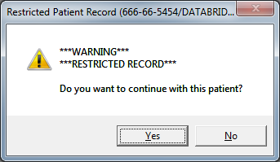
Case Selection – Restricted Access Record
Patients with restricted records will display a warning status.
Click “Yes” to continue and open the case.
If the users proceeds into this record, they will be tracked.

Slide 9
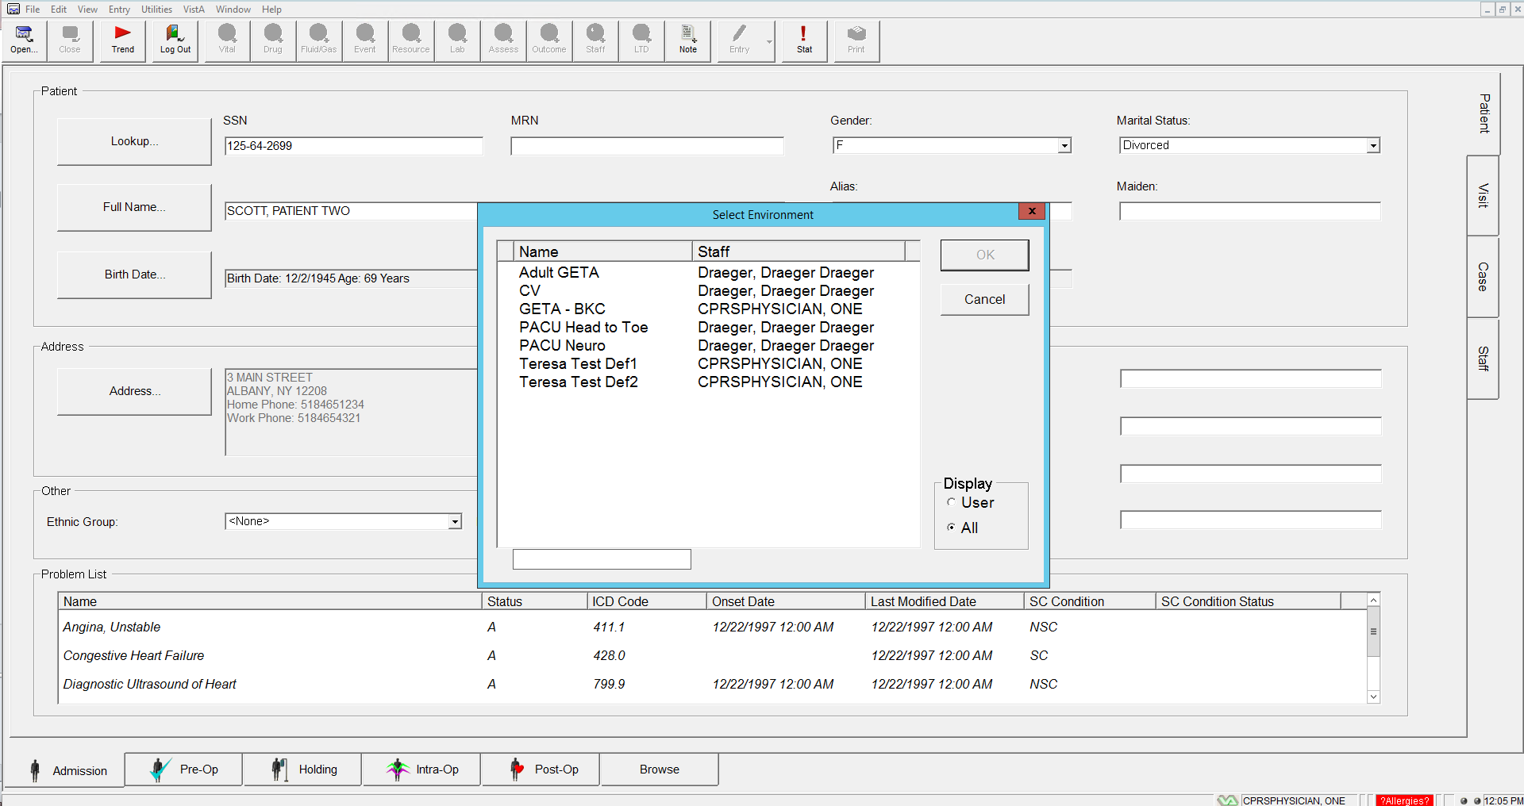
Case Selection – Choosing an Environment
Environments are templates designed to facilitate documentation of a particular care sequence.

Slide 10
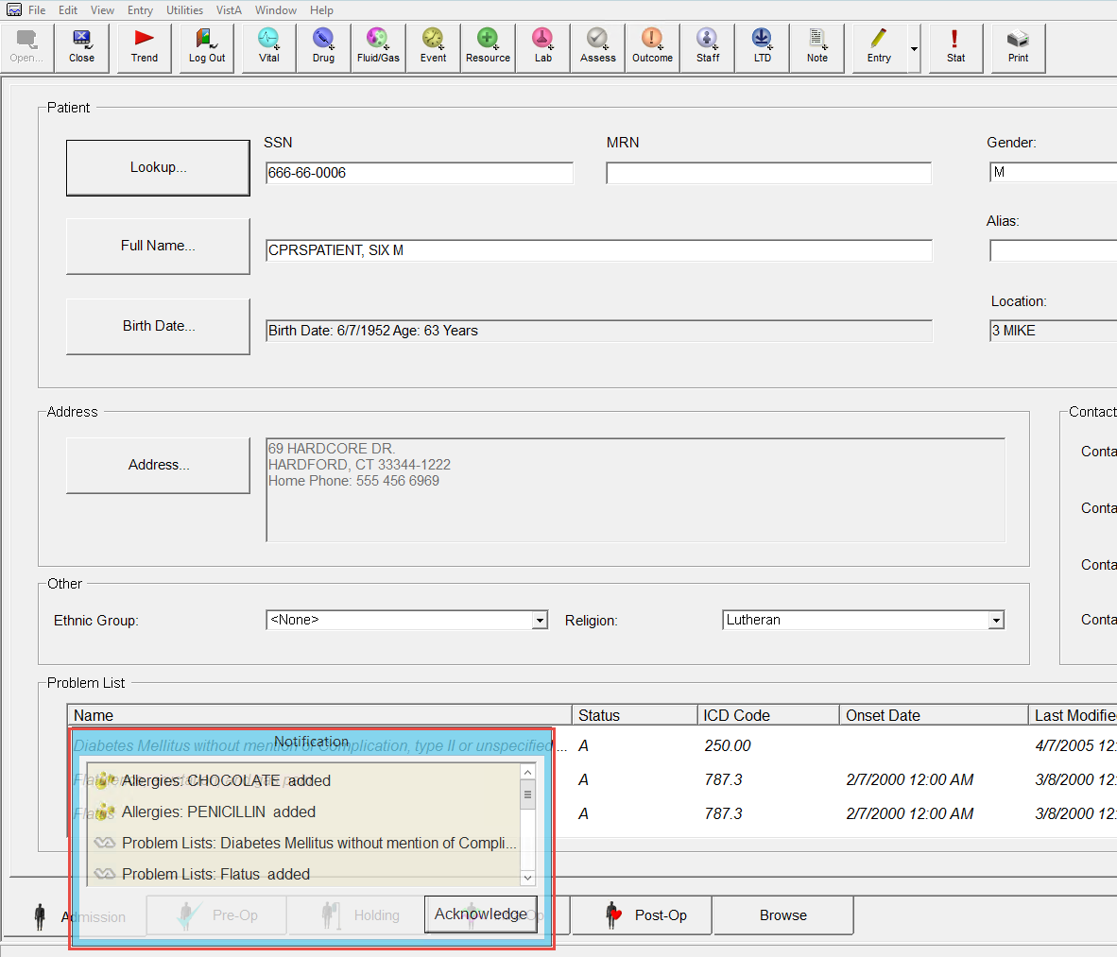
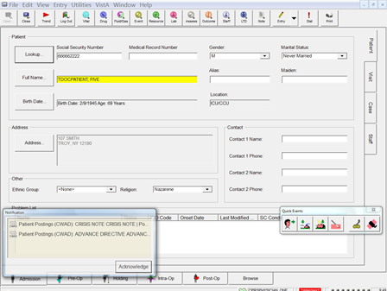
Patient Notifications – Initial Upon Opening Case and During a Case
Upon entering the case, if there are any Notifications, they will show in a pop up window as illustrated below.
Acknowledging the Notification validates receipt of the values and documents on the patient record.
Notifications include allergies, labs, vital signs, problem lists, and pateint postings (CWADS).
The Notifications box will not disappear until you click Acknowledge
User may get Notifications during a case if labs are sent out during the case.

Slide 11

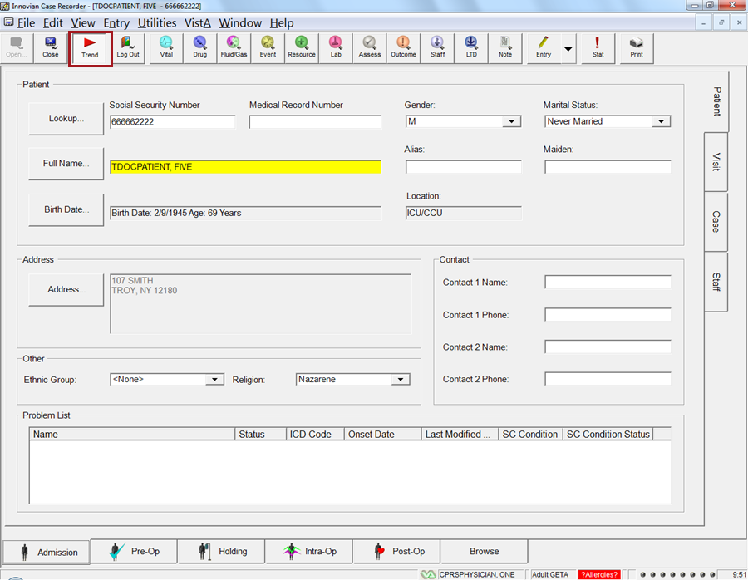
Trending
Select Trend to start the collection of the device data into the record

Slide 12
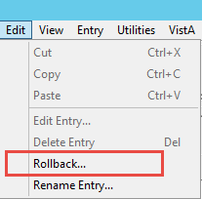
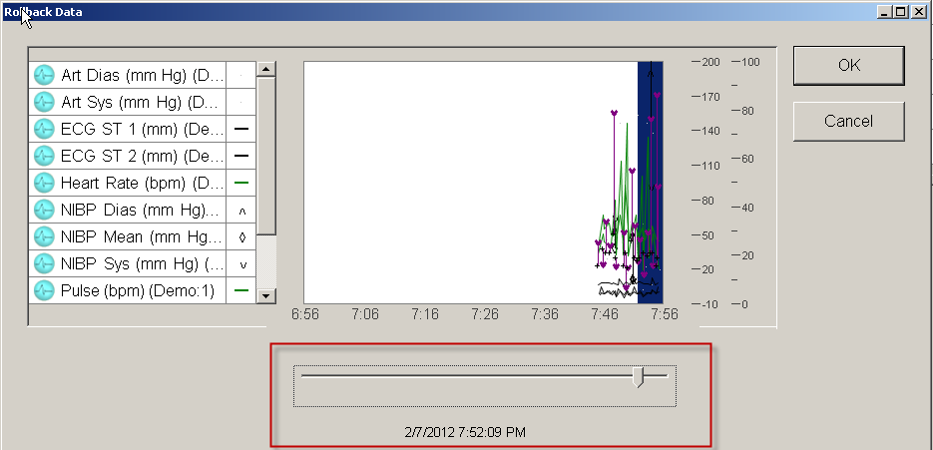
Rollback
If the user forgets to click Trend at the beginning of the case, the patient’s data is stored in the buffer for the last 60 minutes. Click Edit and then Rollback to add the patient data to case.
The Rollback window will open. Move the slider to the left to select how much data to include on the patient’s record

Slide 13
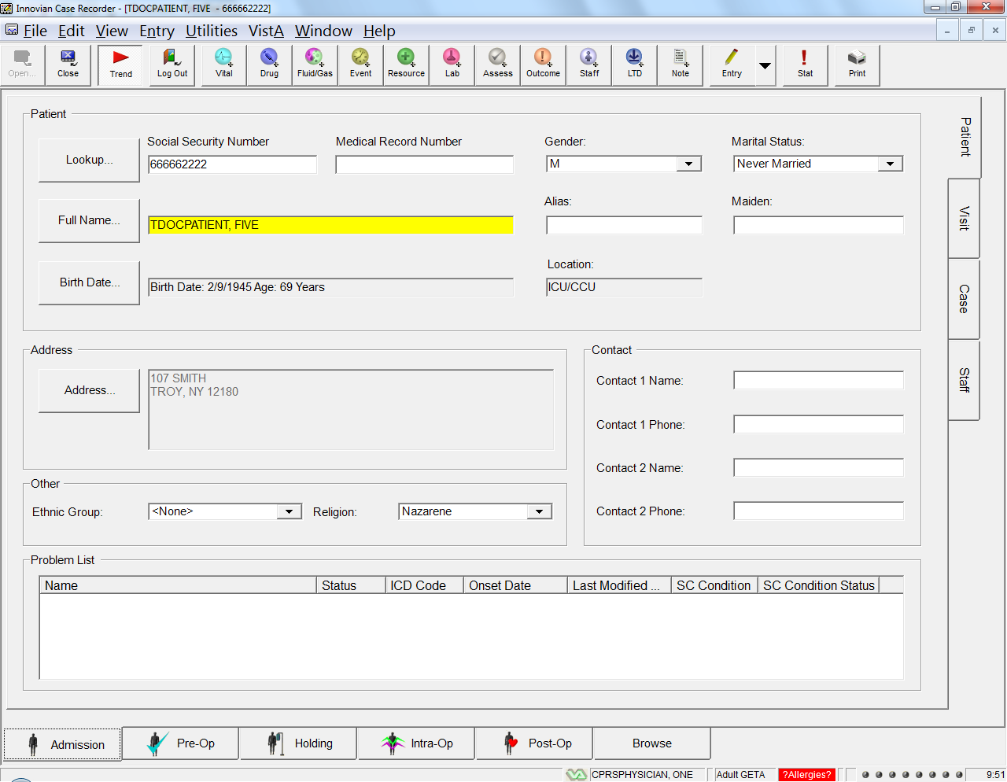
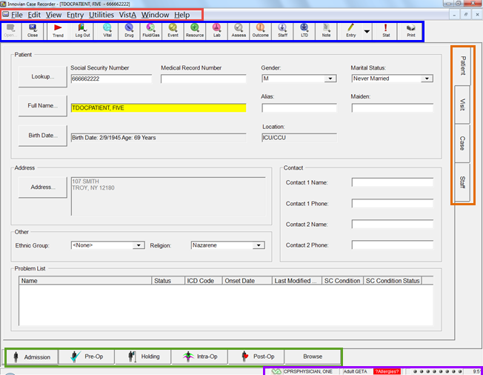
Basic Overview of Case Recorder
File Menu Options
Main Toolbar
Pages
Care Areas - Tabs
Status Bar
Notes:
A. File Menu
File – Open Case, New Case, Trend, Log Out & Exit
Edit – Delete Entry, Rollback
View – Different Care Areas, Case View Settings, Quick Events Toolbar, Repeat Reminders, Missing Required Data
Entry – Manual Vitals Event (often used to document PACU hand-off vitals)
Utilities – System Config (View only, changes made through LM/Utilities/System Config), Workstation Configuration (sets the default settings/function of workstation – must be set on every workstation)
VistA – View of CPRS labs (Interim, cumulative), progress notes, vitals & view of VistA system configuration settings
Windows – Only one case can be opened at a time because of CPRS/VistA integration
Help – Defines the version of Innovian that is installed
B. Main Toolbar
Open - grayed out when a case is open. Only one case can be opened at a time because of CPRS/VistA integration
Close – closes the case. Cases should be closed using this icon and not the upper right hand corner red “x”.
Trend – begins/ends the collection of device data
Log Out – logs you out of Innovian. A case must be closed if you are finished, or a case can be logged off and still continue to collect data if the case is being handed off to another clinician.
Vital, Drug, Fluid/Gases, Event, Resource (positioning devices), Lab, Assess, Staff, LTD (lines, tubes & drains) are used to add a manual entry item to the record.
Note – shortcut to the CPRS progress notes
Entry – used to edit or delete an entry (easier ways, such as the delete key on the keyboard)
Stat – used as a place holder for an event that one may not have time to document because of patient care. Stat event placeholder can be deleted after documentation of the event has been aligned. a Stat can be used at the beginning and end of an occurrence to capture the total time.
Print – Default printer. On clinical workstations the default printer must be PDF Creator.
C. & D. Care Areas & Pages - Review the pages for each care area
E. Status Bar
VA indicators
Environment
Allergy indicator
Device indicator lights

Slide 14
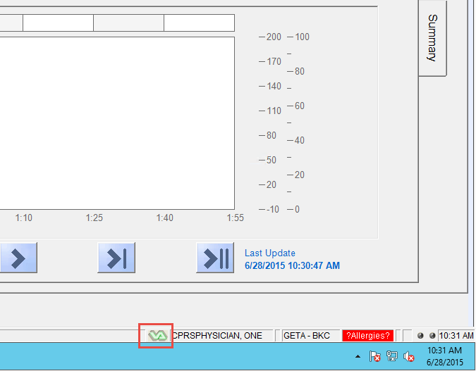
Basic Overview of Case Recorder - Status Indicators
The VistA status icon is located to the left of the Innvovian status bar (as illustrated here) has the following meanings:
    Constant connection between VistA and Innovian Anesthesia
    Allows updates to labs, vitals, problems, clinical warnings, and allergies
    Verify the system has connectivity, the green dots.
Connected to VistA
Not Connected to VistA
Synchronizing VistA Data
Notes:
These are the most frequently seen icons.
Each of them have additional meanings as described in the following slide.

Slide 15
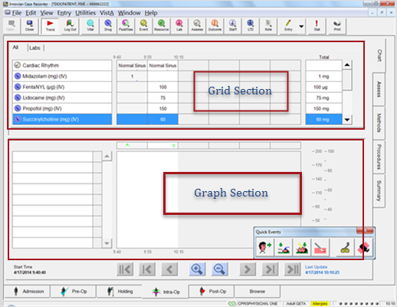
Basic Overview of Case Recorder - Chart Grid & Graph Sections
Chart area:
    Grid – displays
      drugs & fluids
      labs
      numeric values for physiological data
    Graph – displays all configured physiological data from both monitor & / anesthesia machine
The Quick Events Toolbar appears in the lower right corner
Notes:
Trend should have been selected, if not select Trend now. Explain that once Trend is selected, one could take care of his/her patient and begin charting when able. Show Rollback because there should be data in the buffer if you started trending earlier in the case. Tell them that while Trend should be the first thing done on every record, once opened. The Rollback will collect data for an hour if one forgets to press Trend. Explain the Quick Events toolbar.
Toggle:
Patient Arrives in Operating Room & Patient Leaves the Operating Room
Induction & Emergence
Intubation & Extubation
Start of Surgery & End of Surgery
Non-Toggle: (Only metion and explain that these will be discussed in more detail later)
Clamp tool displays a shortcut to the Clamps dialog box
Tourniquet tool displays a shortcut to the Tourniquet dialog box
2. Select “Patient Arrives in the Operating Room”. Point out how the arrow turns from green to red and the next time the item is selected, “Patient Leaves the Operating Room” will be placed on the record. Show the Summary page and explain that some items can be preconfigured to come into the record based on the documentation of another Event. In this case “Patient Arrives in the Operating Room” brought in “Start of Anesthesia Care, Chart reviewed, monitors applied are just some examples of what may have triggered in.
Document a:
Drug – Point out the Favorites, the All and the drug class tabs. Explain that this will be seen in each Innovian icon, if configured. Document Ancef 1 gm using the Drug icon.
3. Select Induction on the toolbar (validate the Event statement “Vital signs reassessed immediately prior to planned anesthetic or induction”)
4. Select Intubation on the toolbar (Anesthesia turnover to surgeon may be triggered)
Drug – Document Versed (Midazolam), Fentanyl, Propofol & a muscle relaxant from the Chart Grid. Use the Events Clock to align Midazolam with monitors applied and Fentanyl, Propofol & the muscle relaxant with induction. Add a Propofol infusion to show the difference between a single dose vs infusion. Drug infusion shows as a blue line and the total calculates based on weight.
5. Document “Start of Surgery” and continue with documentation of the following:
Fluid – IV Lactated Ringers (auto) point out how multiple doses total on the right. Explain that there are different totaling methods that will be covered in the Super User Session. Dose Packed Cells and expand the more to document the unit#, indication & signs of adverse reaction.
Event – Point out highlighted items as being Required. You can apply a warming unit with repeat reminders for the temperature of the device. Document Present during induction and all critical points of care. Did it require a signature? Events are things that you do for the patient.
Resource – Positioning devices.
Assessment – Add ECG from the Chart grid, showing the repeat reminder vs copy on the Assess page. Explain that the reminder feature can be used in Drugs to set a reminder to redose an antibiotic, or in Labs to be reminded to draw a lab. Select the Assess icon and document TOF. Show how the Assessments display on the Main Chart Grid section (if configured in LM & EM) and on the Assess page.
Staff – Add a surgeon and anesthesia provider. Show that these document on the Staff page and can be added anytime during the case. Sign your electronic signature using the pen.
Dose additional medications.
LTD – Document an existing IV vs new line
Stat – Select and show the placeholder on the Summary page and how it can be used for documenting an Event, Drug etc., using the Events Clock.
Methods & Procedures will be reviewed on the following slides.

Slide 16
Basic Overview of Case Recorder - Main Toolbar
Shortcuts to different list items for use in documenting care:
Open: Grayed out when a case is opened - Only one case can be opened at a time.
Close: Shuts the case file
Trend: Begins/ends the collection of physiological data
Log Out: Logs you out of Innovian
Vital, Drug, Fluid/Gases, Event, Resource (positioning devices), Lab, Assess, Staff, LTD (lines, tubes & drains): Manual entry fields
Outcomes: Quality indicators
Note: Shortcut to the CPRS progress notes
Entry: Edits or deletes an entry
Stat: Places holder to mark an event
Print: Sends care record to VistA imaging
Notes:
B. Innovian Icons
Open - grayed out when a case is open. Only one case can be opened at a time because of CPRS/VistA integration
Close – closes the case. Cases should be closed using this icon and not the upper right hand corner red “x”.
Trend – begins/ends the collection of device data
Log Out – logs you out of Innovian. A case must be closed if you are finished, or a case can be logged off and still continue to collect data if the case is being handed off to another clinician.
Vital, Drug, Fluid/Gases, Event, Resource (positioning devices), Lab, Assess, Staff, LTD (lines, tubes & drains for documenting existing (In Situ) or new Lines, Tubes or Drains.
) are used to add a manual entry item to the record.
Note – shortcut to the CPRS progress notes
Entry – used to edit or delete an entry (easier ways, such as the delete key on the keyboard)
Stat – used as a place holder for an event that one may not have time to document because of patient care. Stat event placeholder can be deleted after documentation of the event has been aligned. a Stat can be used at the beginning and end of an occurrence to capture the total time.
Print – Default printer. On clinical workstations the default printer must be PDF Creator.

Slide 17

Basic Overview of Case Recorder - Quick Events Tool Bar
Induction / Emergence
Start Surgery / End Surgery
Tourniquet
Patient Arrives / Patient Leaves
Intubation/ Extubation
Clamp
  Begin on the left toggle button of the Quick Events Toolbar, as the case progresses select to the right of the previous button.
  Icon arrows turn red for the opposite activity - Patient Leave the OR.
  Clamp & tourniquet are additional buttons for short cuts for the procedures.

Slide 18
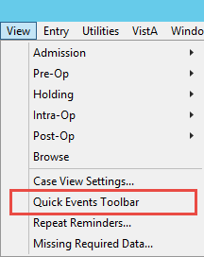

Basic Overview of Case Recorder - Refreshing Quick Event Toolbar
You must close the Quick Events Toolbar (only exception to use the X button) if charting retrospective to allow the milestones to be entered manually to trigger other events in the correct time sequence.
If you close the Quick Events Toolbar, it can be reopened by accessing the View drop down menu, then select Quick Events Toolbar.

Slide 19
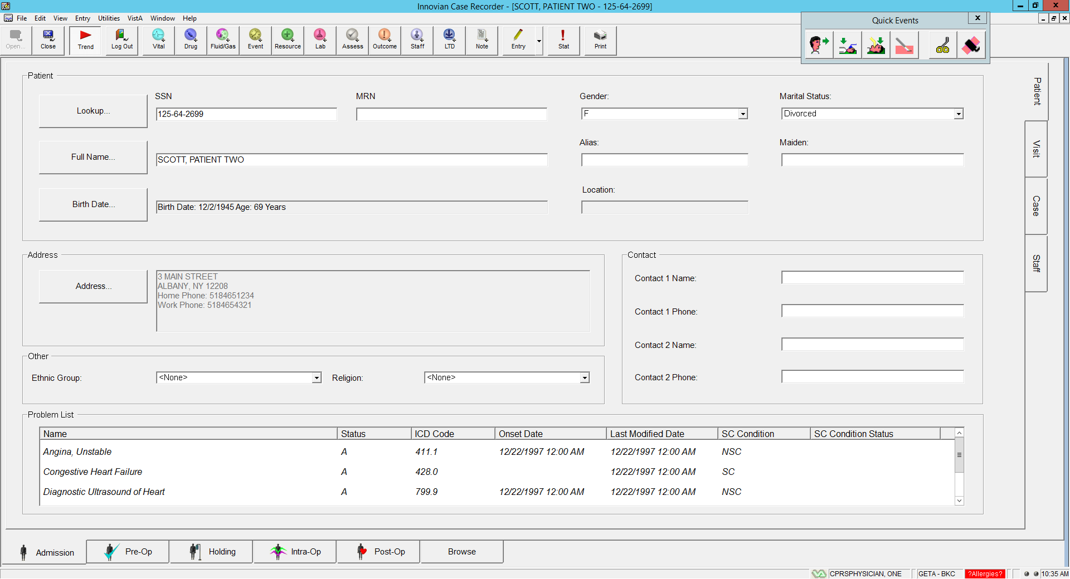
Admission – Patient Page
This page contains demographic information.
The Problem List is shown in the Patient tab of the Admissions page.
This comes from an existing list in VistA CPRS and cannot be modified in Innovian.
Notes:
Loads Problem List on initial opening of case record. Polling can be set to add problems through out the case
The Problem List is shown in the Patient tab of the Admissions page. This comes from an existing list in VistA CPRS and cannot be modified in Innovian.

Slide 20
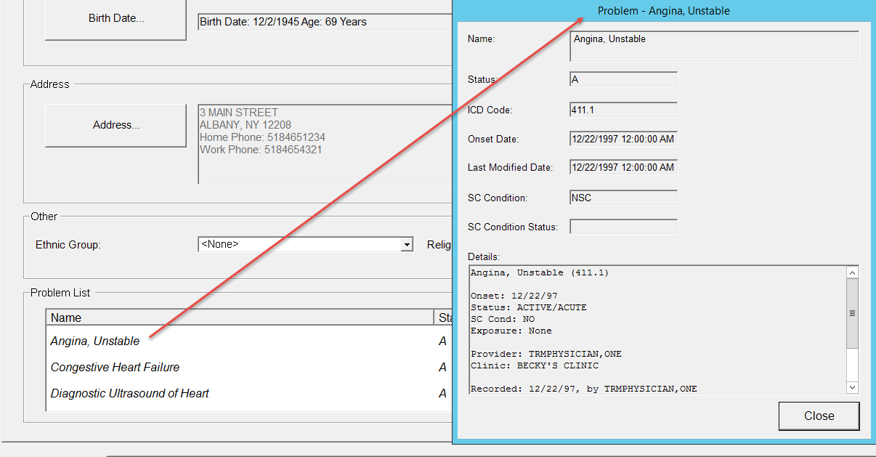
Problem List – Details
Double click on any of the items in the Problem List to open a window showing additional details.

Slide 21
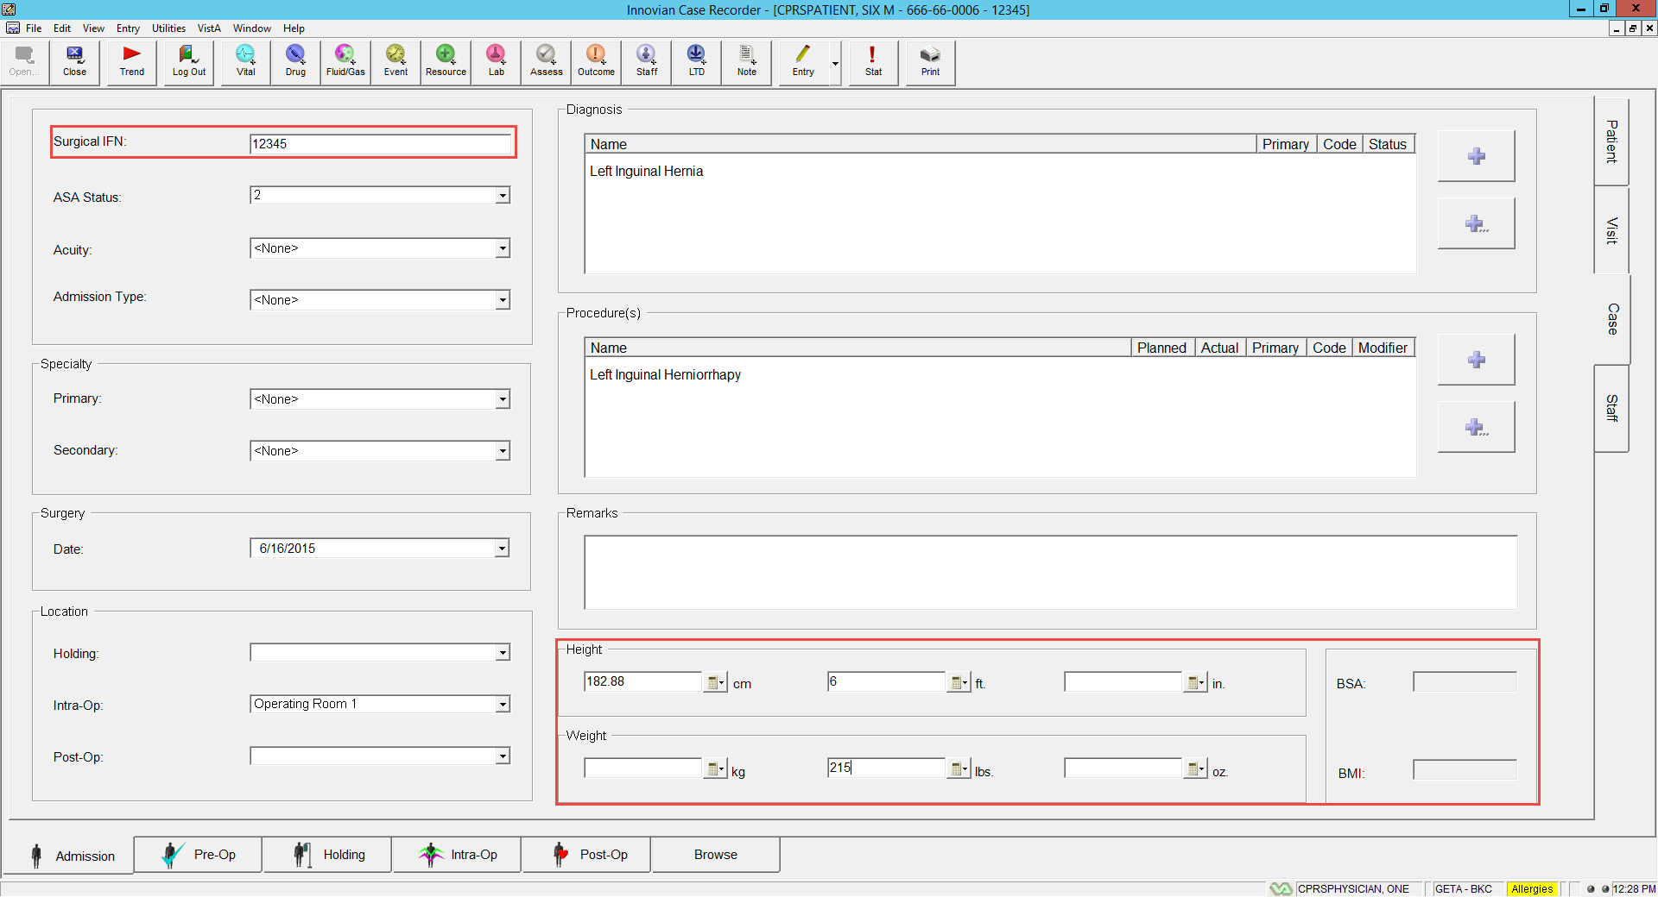

Admission – Case Page
IFN = Internal File Number (Cannot print to CPRS/VistA Imaging if no IFN)
Height and Weight are populated in Innovian from CPRS. You can edit them in Innovian but the edit will not write back to CPRS.
Surgical Diagnosis & Procedure – Update / Add if necessary (NEEDS TO BE CHANGED IF YOU HAD SELECTED THE WRONG PATIENT INITIALLY)
Notes:
IFN
Unique identifier that identifies each surgical case in VistA
Innovian does not use or need it, but VistA uses it to associate Progress Note (TIU Note) with the case.
All surgical cases must have an IFN
This number will be mapped to the Case Field.
This field can be edited to enter the IFN

Slide 22
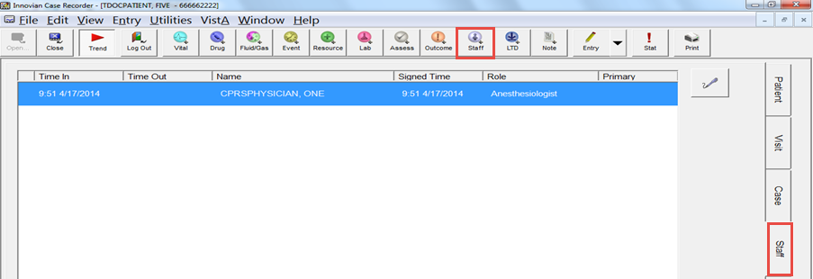
Admission – Staff Page
Do Not add your name to Staff Page until you have hit the TREND button.
Add or select your name via the Staff icon. Each role must be added.
You will be prompted to enter your e-signature.
Staff pulled from VistA will appear in Italics on the Staff page, double click highlighted row and select OK to add.
If the staff changes, delete the entry and add provider using the Staff icon.
Notes:
If Staff Role of Surgeon, or other is set on Com Sys tab of System Configuration, the name cannot be edited.
Roles have been predefined based on VistA Surgery Package Requirements:
SURGEON – Surgery Resident
PRIN. ANES. – CRNA or Anesthesia Resident
ATT. SURGEON – Surgeon of Record
RELIEF ANESTHETIST – Relief
ASSISTANT ANESTHETIST
ANES. SUPER. – Supervising Anesthesiologist

Slide 23
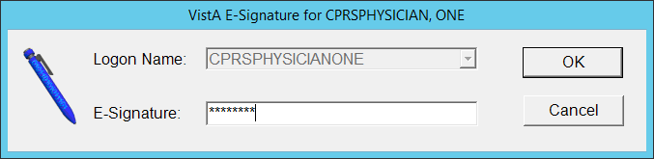
E-signature
The E-Signature dialog box uses the users CPRS E-signature.
It is the same e-signature code used in CPRS for orders or progress notes.

Slide 24
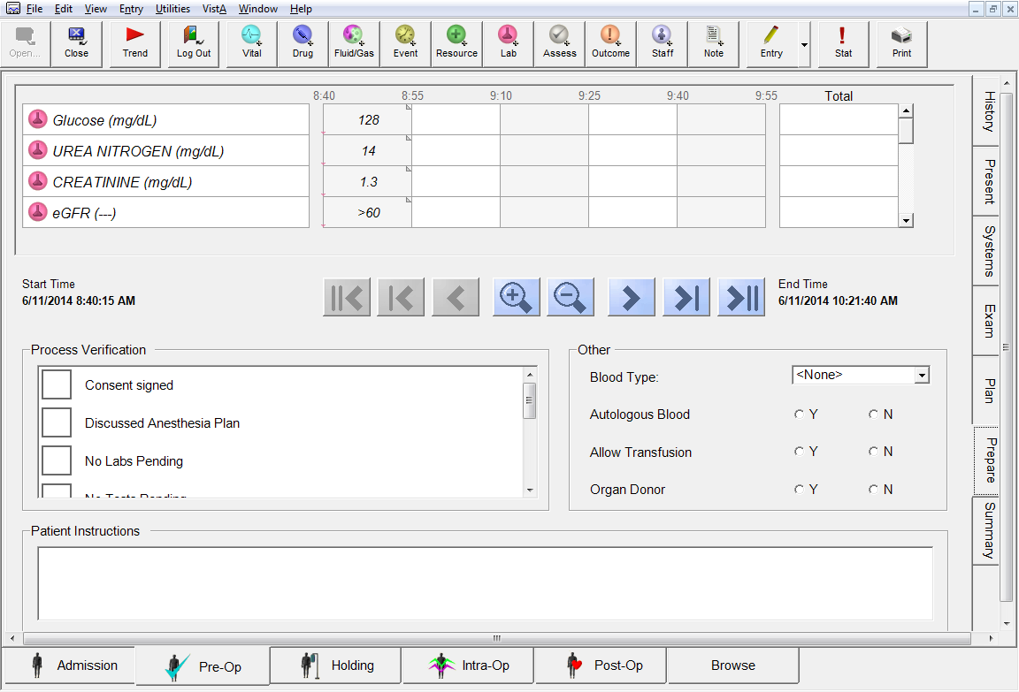
Pre-Op – Prepare Page
Vital signs and laboratory data acknowledged from the Notification display.
The blood type is not automatically populated. Use CPRS as the “true source” for blood type. Leave the field blank.
You can also view pre op labs by going to the menu bar and clicking Vista then CPRS Labs/Vitals

Slide 25
Intraop Documentation Process
Notes:
Step 1 – Login with Access & Verify credentials
Step 2 - Check Connectivity – green lights in lower right hand corner
Step 3 – correct Intraop care area – Yes or No
Step 4 – Open case, select patient
Step 5 – Prompt to Load Environment – Yes or No? Select or Cancel
Step 6 – Start Trending
Step 7 – Document Case Care
Subprocess for 1 - Chart Intraop Care; 2 - Go to Admissions for Staff & Case; 3 – Go to Holding tab for Status.
Step 8 – Case completed; View Menu for Missing Data
Step 9 – Stop Trending
Step 10 – Does the record have End of Anesthesia Care or End of Intraop Record Yes or No (Same decisions)
Step 11 – Print (add picture of print icon)
Step 12 – Close
Step 13 - Log Out

Slide 26
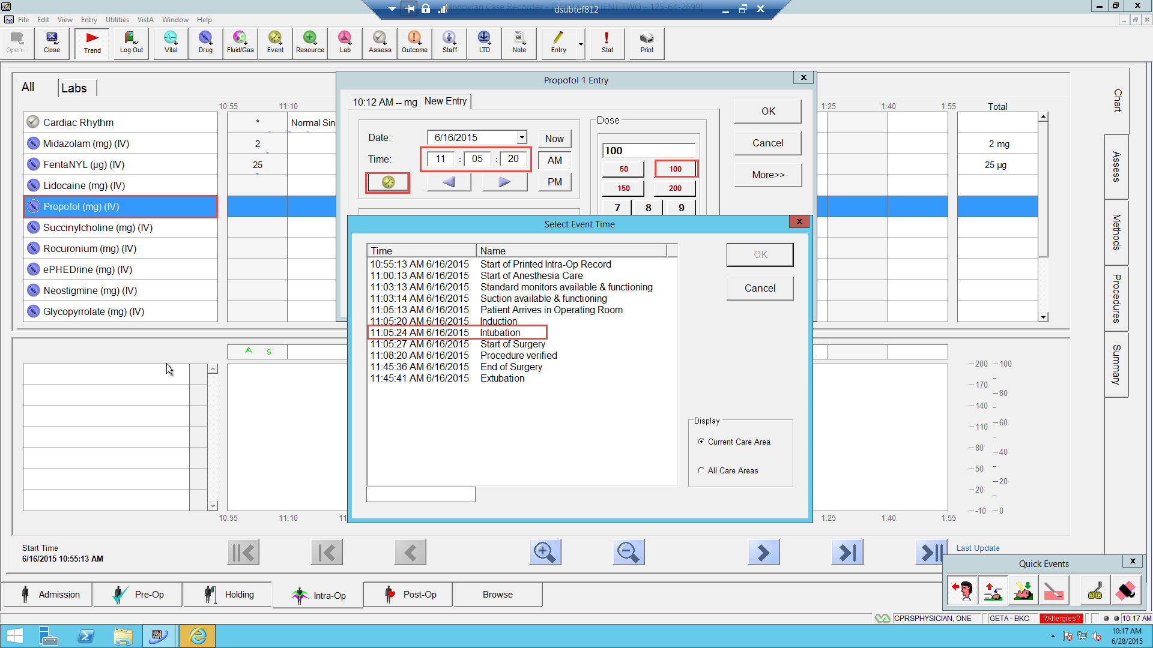
Documenting Drugs
  Double-click the drug from the grid or select Drug from the toolbar.
  The New Entry window opens.
  The yellow Event Clock can be used to associate a drug with an event to define the time the drug was given.
  The dose can be keyed in or chosen from the Quick Pick Doses

Slide 27
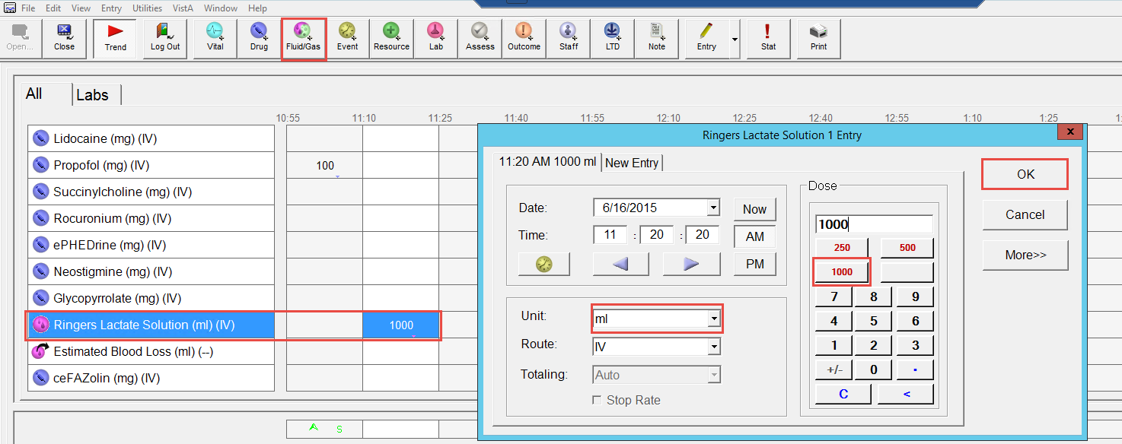
Documenting Fluids
Click Fluid/Gas icon from the toolbar or double-click if there are fluids on the grid from your Environment.
Choose the desired Fluid and click Edit.
The yellow Event Clock can be used to associate the fluid with another event to determine the time administered.
Choose the Unit. ml is for a total amount infused. ml/hr is used to document continuous infusions.
Click OK or Finish to close all windows.
Notes:
Choosing “More” when administering blood products allow the user to document the ID #, Indication, & No Signs of Adverse Reaction

Slide 28
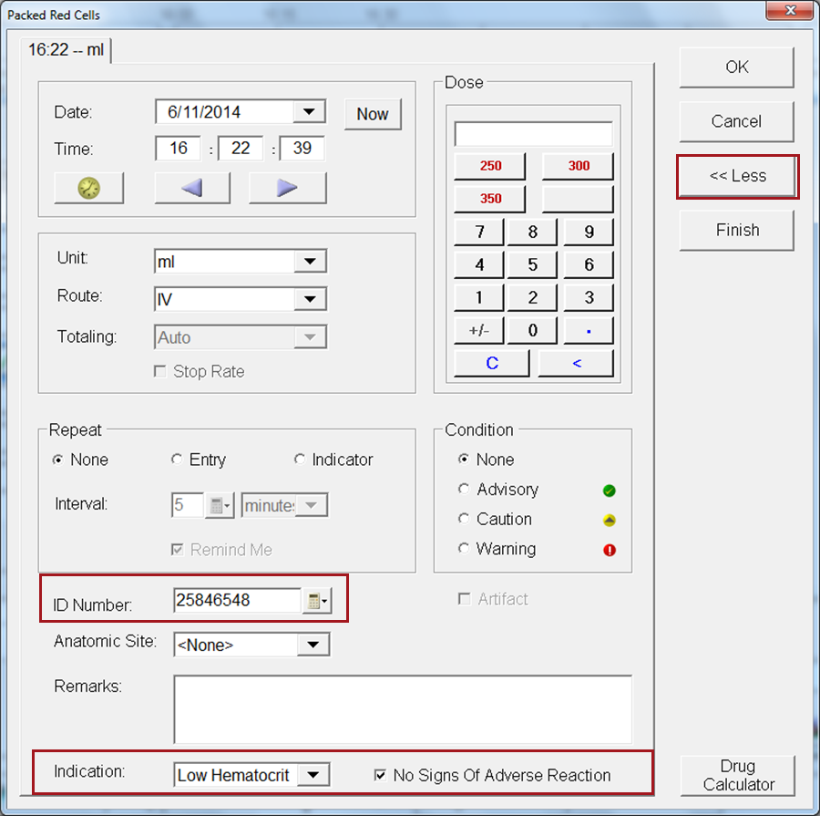
Documenting Fluids & Blood Products
Select the More button to document additional information for blood products
Options include:
  ID Number
  Indication for transfusion
  Indicator for Adverse Reactions
Notes:
Choosing “More” when administering blood products allow the user to document the ID #, Indication, & No Signs of Adverse Reaction

Slide 29
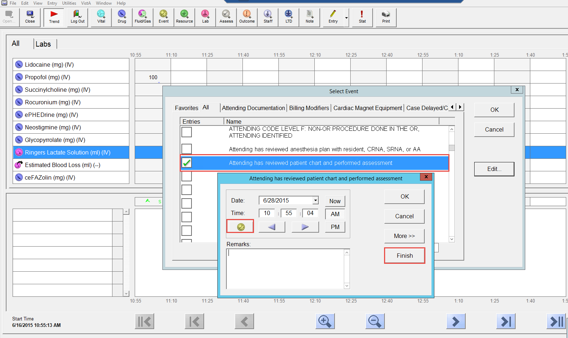
Documenting Events
  Is used to document narrative patient care activities.
  Click the Event icon on the toolbar.
  Select the Event from any of the tabs.
  A “Speed Search” can also be performed by typing into the white space at the bottom of the window.
  The yellow Event Clock can be used to associate this event with another event as seen in the previous slide.
  Click Finish to close all windows.

Slide 30
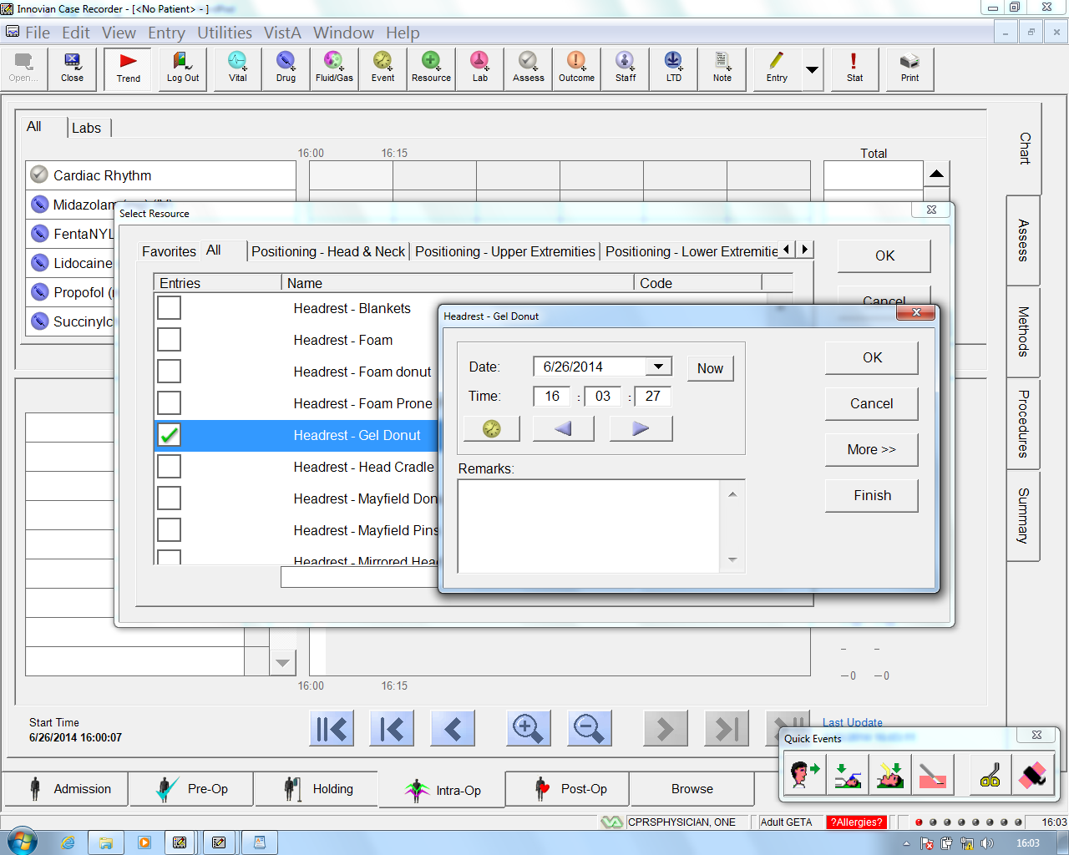
Documenting Resources
Use Resources to document a Narrative Note.
Use Resource button to find your “Timeout” Statement
Used to document positioning devices:
Includes items like:
    Headrest
    Armboards
    Pillows
    Sleds
    Special Tables
    Padding
Notes:
Used to document devices used to position the patient.

Slide 31
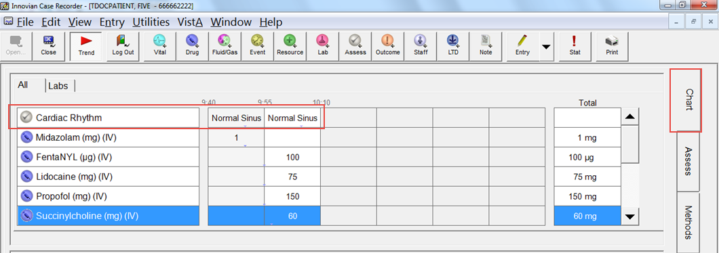
Documenting Assessments on the Grid
Placed on the main Chart grid
Placed on the Assess page
Notes:
ECG & TOF are examples of assessments that can be placed on the Main Chart Grid or on the Assessment page.
This is configured within List Manager and Environment Manager.

Slide 32
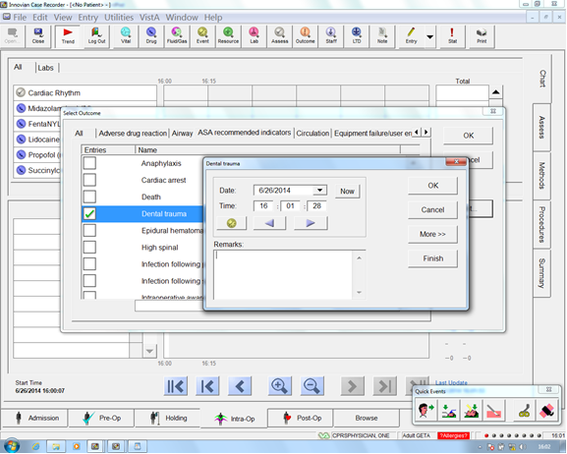
Outcomes
Used to document quality measures.
Click the “Outcomes” button on the Tool Bar and choose the statement that reflects the event

Slide 33
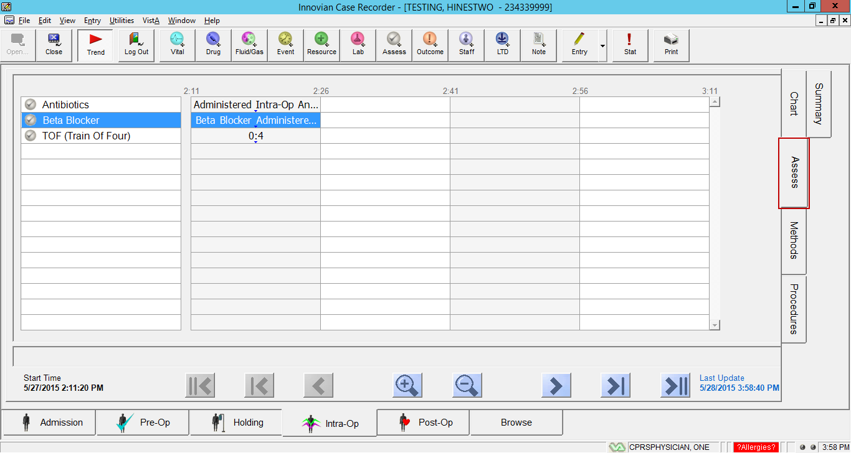
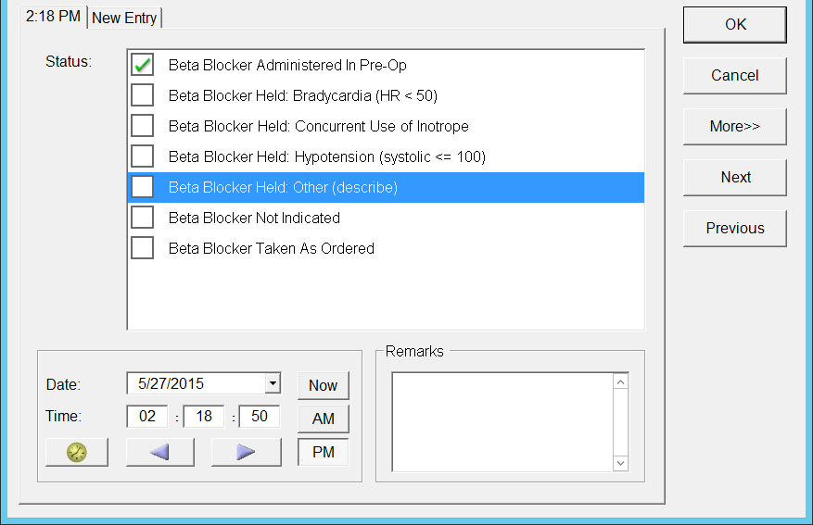
Assessments
Can be used to document:
      SCIP Measures Antibiotics & Beta Blocker
      Cardiac Rhythm
      Train of Four
Double-click to begin
Use the Next button to assess your next parameter. This action will assign the same time stamp to all assessments.
Notes:
The entry dialog boxes that open on the Assess tab of the Post-Op page have a Next and Previous button, which
enable the following:
– Clinicians can enter a “set” of entries, all of which are automatically assigned the same time
– More convenient data entry
– More effective “repeat entries”

Slide 34
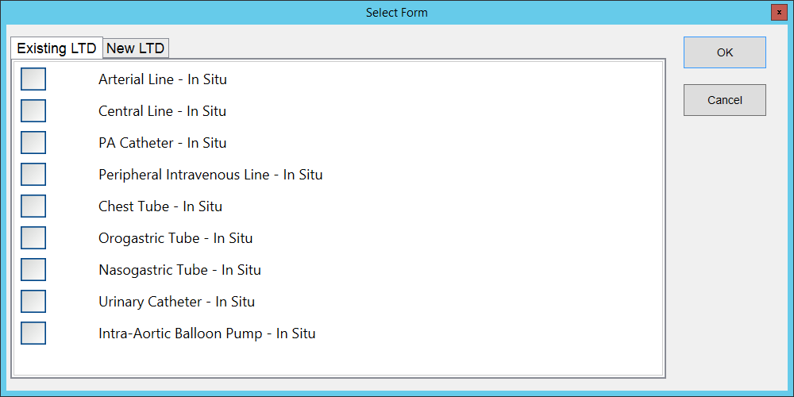
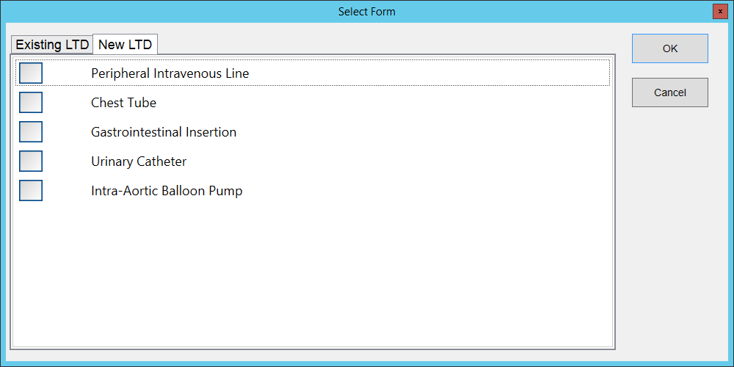
Lines, Tubes, & Drains (LTD)
Selecting the LTD button displays a dialog box of existing or new selections.

Slide 35
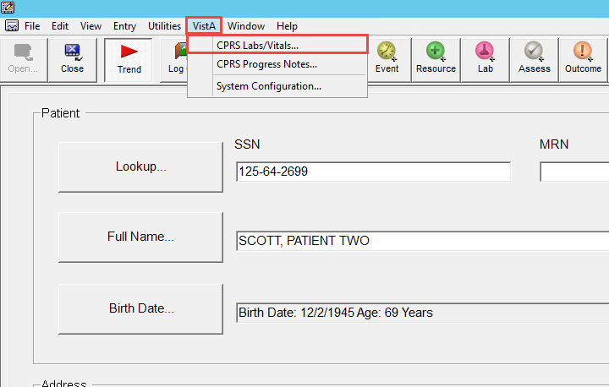
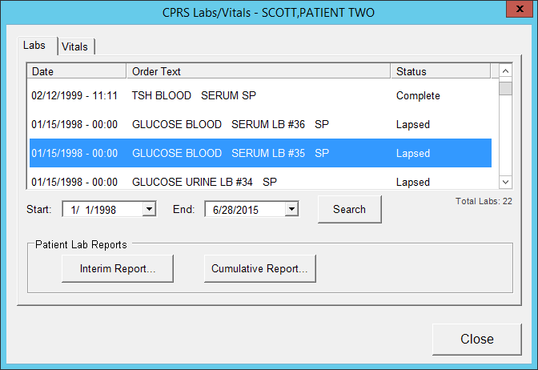
VistA Menu – Labs & Vitals
This menu allows you to look into CPRS via Innovian for Labs & Vitals

Slide 36

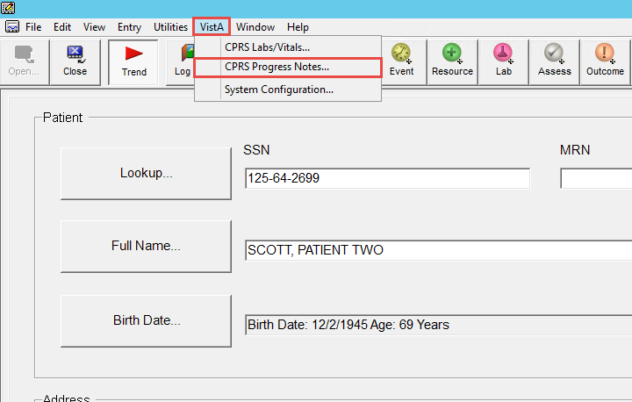
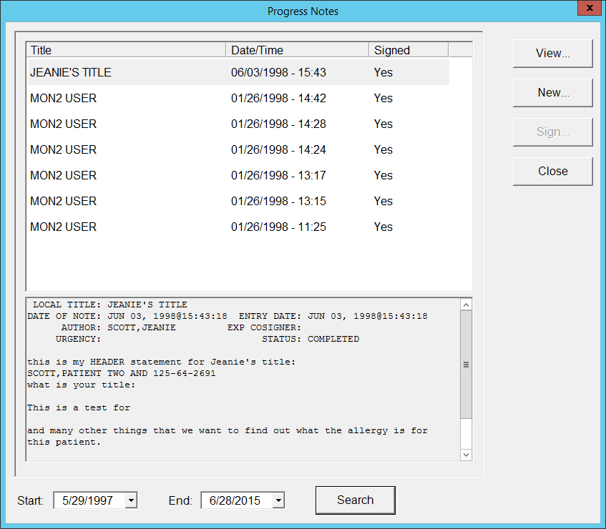
Vista Menu - Progress Notes
In Recorder, from the VistA menu, select CPRS Progress Notes. The Progress Notes list will be displayed. (Progress Notes are also known as “TIU Notes”)
Progress Notes can also be accessed through the Note Toolbar button.
Notes:
Progress Notes that exist in CPRS can be viewed and created in Innovian Anesthesia.
When notes are created – predefined template has been created that will display specific events or data from the case – start / end of anesthesia care; start/end of surgery; anesthesia providers; medications, etc..
In order to print a record, a Progress Note must be created and an e-signature may be required based on your facility’s process.

Slide 37
Vista Menu - Progress Notes
Provides the ability to view existing CPRS progress notes.
Select View to review the contents.
The default search range is the last 30 days.
Use the down arrow to change the date.
Notes:
If a note is created with “Remarks Only” – only the information typed in will be sent to CPRS; No data elements from the case will be included.

Slide 38
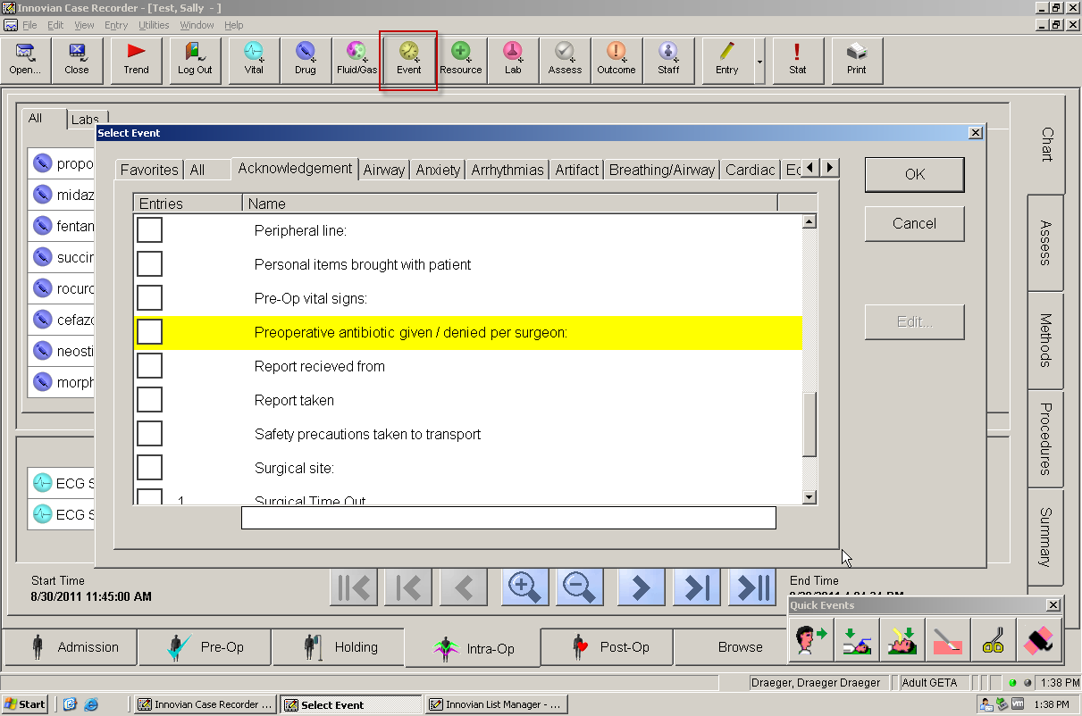
Required Fields
Required data will be highlighted in yellow must be completed prior to printing.

Slide 39
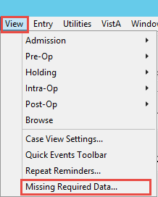
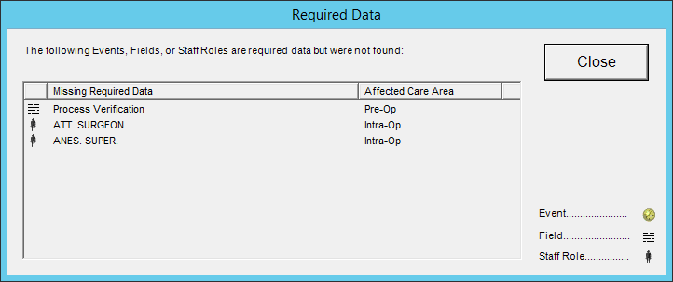
Missing Required Data
At anytime during the case, the user can verify all required data has been completed.
Go to View then select Missing Required Data.

Slide 40
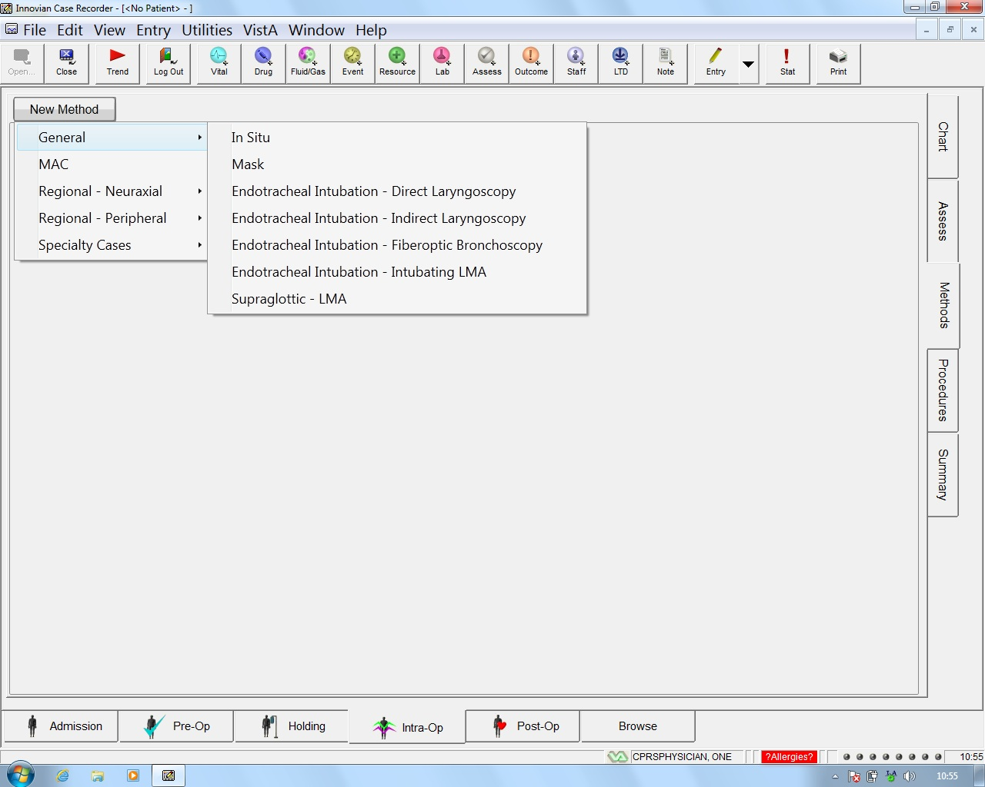
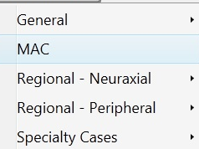
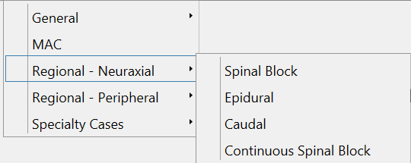
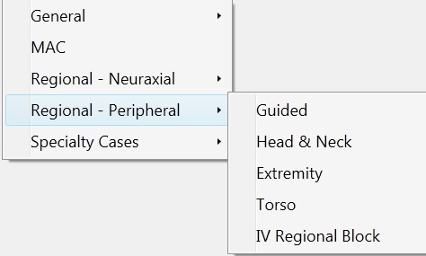
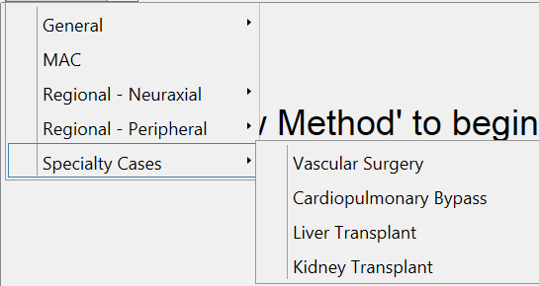
Available Methods Forms
General
MAC
Regional Neuraxial
Regional Peripheral
Specialty Cases
Notes:
Available Method Forms consist of General, MAC, Regional Neuraxial, Regional Peripheral and Specialty Cases.
Each form is designed to allow for complete documentation of items associated with that type of anesthesia.
The forms keep the same layout of information.

Slide 41
IntraOp – Selecting a Method
Select New Method to display available techniques
Select the corresponding case type
Notes:
Select New Method, General & Endotracheal Intubation – Direct Laryngoscopy.

Slide 42
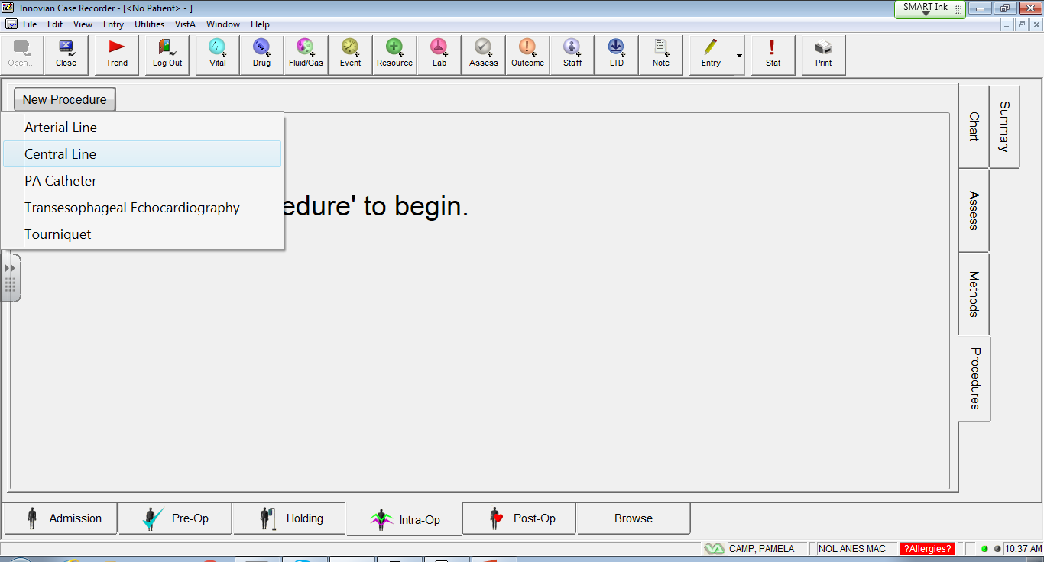
Available Procedure Forms & Selecting a Procedure
Select New Procedure to display available procedure forms
Notes:
Arterial Line/Central Line/TEE -Ability to document laterality, catheter information, time-out, technique and more
Tourniquet - A window displays when you try to close a case with running timers for a Tourniquet. If a timer for a Tourniquet is running when you try to close a case, the Timers Running window displays a list of the running timers, serving as a reminder to return to the case and stop them.

Slide 43
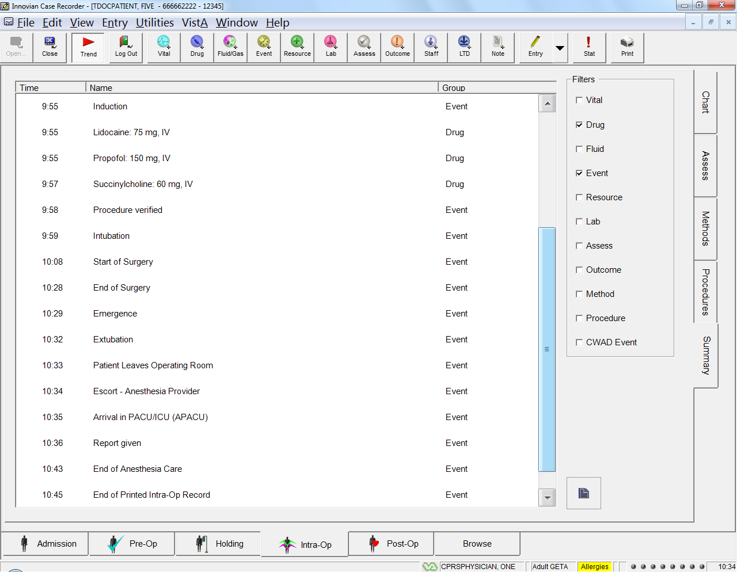
Summary Page – Filters
Use the Summary tab to filter and view case data.
Ability to filter CWAD Events from view
Text in “italics” indicates data brought in from the VistA system.
Data brought in from the VistA sytem cannot be modified or deleted.
These events are not displayed in the printed records.
Notes:
If you highlight an entry, select, double click will open the form
If you highlight an entry, select enter it will open a window which displays the full entry – no …

Slide 44
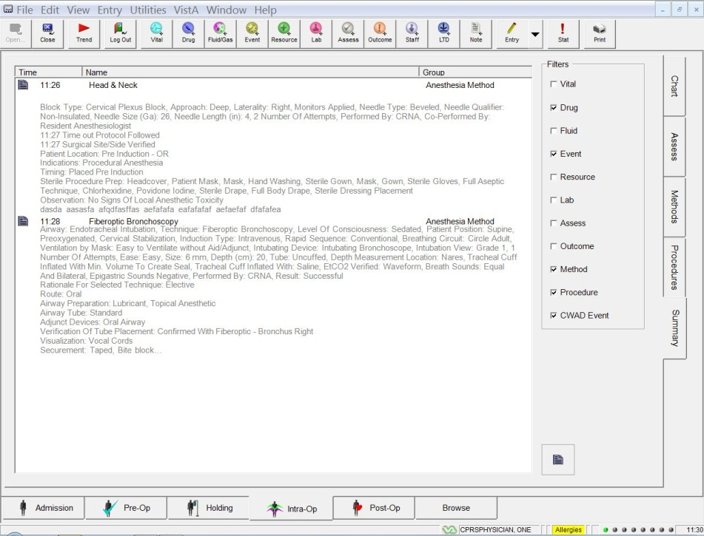

Summary Page – Long Remarks
When the Remarks on the summary page exceed the allowable character length they end with “…”
The entire Remarks text can be displayed by selecting and highlighting the Remark and pressing the Enter key (see next slide)
Notes:
Double clicking brings the user to the method or procedure page for editing if needed
Clicking enter will display all the text
A Summary page will need to be printed in order for long remarks to be displayed. They will still truncate in the intraop record

Slide 45
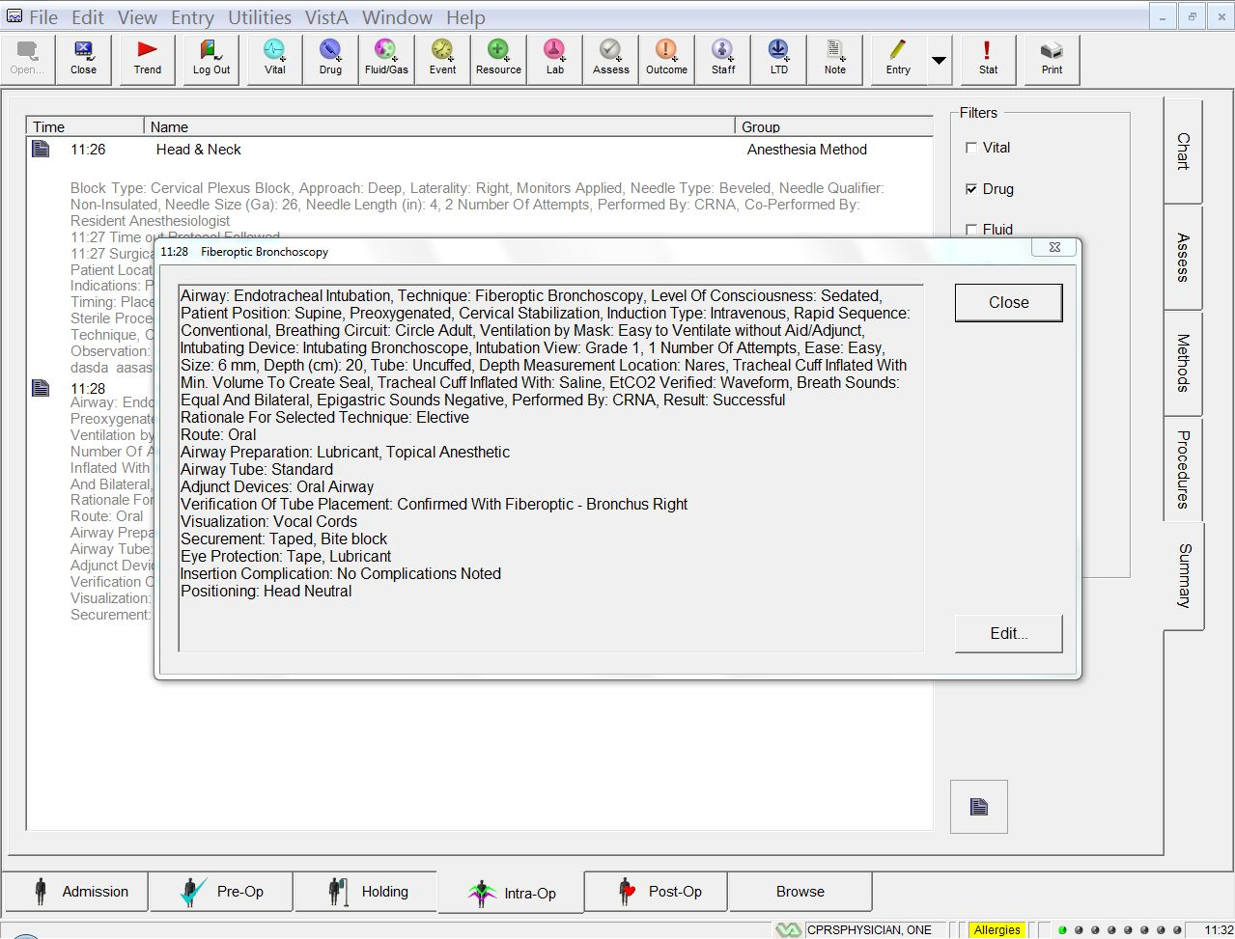
Summary Page – Long Remarks

Slide 46
Completing & Closing the Record
  Ensure End of Surgery, Emergence, Extubation & Patient Leave the Operating Room as appropriate.
  Review the Summary page to ensure your documentation is complete.
  Validate that Required fields are documented.
  Validate all entries are between the Start of Printed IntraOp Record and the End of Printed IntraOp Record.
  CLOSE the record in the OR. Use the Close on the Main Toolbar and NOT EVER the red “X” in the upper right corner
  Follow the organizational policy for documentation of hand off report.
  Logout if you are not returning to the OR.
Notes:
View Missing Required data to see if complete

Slide 48



Printing Process
Step 1: Click Print
Step 2: Click New
Progress Note

Slide 49



Printing Process
Write Remarks Here
Step 3: Select Note Type (NOL ARK ANES) – Click OK
Step 4: Populated Progress Note Appears – Add remarks (if necessary) and Click OK
Step 5: “Do you want to sign the Progress Note “ – Click Yes; “No” will not send the record to VistA Imaging)

Slide 50
Printing Process – Esignature
Step 6: Enter E-Signature – Click OK
If the workstation has been configured to print all reports, but the user only has permission to print their care area record, then they will receive this message – “Not all Selected Reports are Available” Proceed with printing.
Missing name or e-signatures on printed record:
  The case was not e-signed between the start & end of the printed care area (Intraop).
  Verify the case times for the staff member Admission / Staff page versus the start and end of the Intraop printed record (may be care area specific).
Notes:
A PACU clinical workstation may be configured to print an Intra-OP & a Post-Op record, but the Anesthesia provider only has the VistA Key that allows him/her to print Intra-Op records and not Post-Op and the PACU nurse has the Vista key that allows him/her to print the Post-Op record, so they would each receive the message “Not all Selected Reports are Available”. Each would have sent the record that they have permission to print.
A super user must use the File/Print option and deselect the reports they do not want to send. (This is covered in more detail in the Super User session)

Slide 51



Printing Process – Transmission
Report Printing
When you print case reports, it takes approximately one minute to send the PDF images to the shared folder and for Databridge to confirm completion to Innovian Anesthesia
This icon appears middle of the page at the bottom.
Users cannot log out of Case Recorder until transmission is complete, the VistA PDF Image Submission dialog box displays.
When PDF image transmission is complete, a prompt is displayed indicating successful transmission.
Notes:
The “Success” message means that the file was received by Databridge.

Slide 52
Status Icons
Other possible icons that may be seen include:
- Not Connected to VistA – Data Synchronization Disabled
- Not Connected to VistA – PDF Image Submission Error
- Not Connected to VistA – PDF Image Submission Pending
- Connected to VistA – Data Synchronization Disabled
- Connected to VistA - PDF Image Submission Error
- Connected to VistA - PDF Image Submission Pending

Slide 53

Emergency Case Start - Lookup
Click Open then select New Case
Used only if your patient was not listed after selecting Open
In Recorder, from the Admissions Tab, select the Lookup button to open the Select Patient dialog box
Notes:
What is the difference between lookup display and CPRS button?
Lookup allows the users to see a list of patients who have either had cases completed in IA or they been admitted to the hospital based on the filter setting (usually last 7 days)
CPRS allows the selection of a patient who hasn’t been scheduled

Slide 54

Emergency Case - Patient Selection
The Select Patient dialog allow one to search the Innovian patient database. If a patient has been added to Innovian, they will be found here based on the filter settings.
Select the header description and enter your search criteria.
If you cannot find your patient, use the CPRS button to find your patient. (see next slide)

Slide 55

Emergency Case - CPRS Lookup
After selecting the CPRS button, the Select CPRS Patient dialog box appears
The search selection options function just like those in VistA CPRS. Once patient is found, highlight the desired patient name and choose the Select button.

Slide 56
Emergency Case - Printing Process
Step 1: Click Print
Step 2: Click New
Progress Note

Slide 57

Emergency Case Printing Process
Step 3: Select the correct surgery date then click OK

Slide 58


Emergency Case Printing Process
Step 4: Select Note Type – Click OK
Step 5: Populated Progress Note Appears – Add remarks (if necessary) and Click OK
Step 6: “Do you want to sign the Progress Note “ – Click Yes; “No” will not send the record to VistA Imaging)

Slide 59

Non Scheduled Cases - Printing Process
Step 1: Create a Progress note in CPRS (Use note title “NOL ARK ANES” in body of note type “Innovian Record” and sign.
Step 2: In Innovian Click Print
Step 3: Click on the CPRS note
you created at top of list left side
and then click Select.

Slide 60
Non-Scheduled Cases - Printing Process
Step 4: Populated Progress Note Appears – Add remarks (if necessary) and Click OK
Step 5: “Do you want to sign the Progress Note “ – Click Yes; “No” will not send the record to VistA Imaging)

Slide 61
FAQs
Q: Inability to trend / trend button disabled A: The user does not have proper permissions
Q: Duplicate entries A: User clicked a button twice, go to Summary Page and find the duplicate entry and delete one.
Q: Linked items – complete, but receive message indicating missing A: Go to Summary page and look for duplicate entries or missing entries.
Q: Reason for green font summary page A: Your entries are outside the start and stop times of your printed record.
Q: Reason for missing entries on summary page A: The entry was entered outside the start and stop times of your printed record. Also they may want to check the filters on right side of the Summary page to make sure the item is selected they are looking for.
Q: Impact of fluids running – stop rates A: It will increase the length of your printed record.
Q: Name does not appear on record A: User signed name to record before the start time of the printed record.

